Slide 1


Welcome!
Please be aware that some of the sessions are being recorded for sharing later.
We want people to participate but please use the ‘raise hand’ facility to ask questions and contribute when others are talking.
Please be considerate to others - together we want to create a safe, open and reflective space to learn.
You can turn on live captions on by clicking on the 3 dots at the top of your screen if you need this.
The link to the feedback form will be put in the chat.
Please do take the time to complete it after the session.
Thank you!

Slide 2
Learning outcomes
Learning outcomes:
Participants will gain a basic understanding standing of service user engagement and co-production.
Participants will understand how to use tools to understand service user wishes and feelings and use these to inform delivery.
Participants will have the know how to involve family and friends, to help encourage service users to engage in their service.

Slide 3
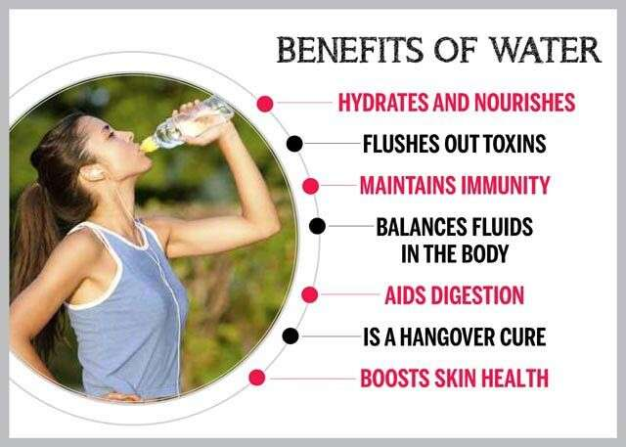
Drinking Game:
Notes:
Ok I thought it might be nice to have a drinking game to liven things up. Obviously I am promoting drinking sensibly, so I suggest water, but if you have tea coffee or something stronger to hand…… What can I say? Cheers!
Any way. I will be alternating from reading from notes and freestyling. So when you think go off script that is when you can raise a glass and take a sip- when you can tell I am reading prepared notes - you are not allowed to drink. Good luck.

Slide 4
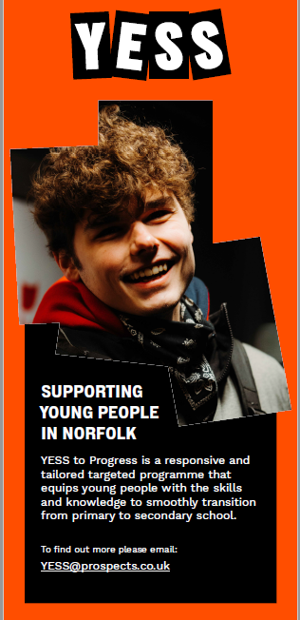

Youth Early Support Service - ‘YESS’ delivered by Prospects, Part of Shaw Trust.
Deliver Youth Services and work and health programme across Norfolk.
Nationally, Shaw Trust supports over 80,000 young people per year.
Last quarter, 98% of young people we supported in Norfolk said that their youth worker listened to them and understood their worries
Last quarter, 81% of young people we supported in Norfolk said that they have developed resilience and other skills which helped them make positive changes.
Notes:
I work for Shaw Trust, who are the 17th biggest charity in the UK.
S/T is more known to work with adults and a lot of this is around supporting people with barriers to employment Working Health Programme, CFO3 (supporting ex offenders to get back into society) and many others..
We also have some other areas like Ixion who work with Apprenticeships and Traineeships, Homes to Inspire, who run Childrens homes all over the UK.
They are part of our Children and Young persons department – within this is Prospects. Prospects works in London, Birmigham and Gloucester and here in Norfolk.
We work with over 80,000 yp across the country. Don’t ask me for their names, I can not remember them all!
Here in Norfolk we have been delivering the Norfolk Connect programme for the last 5 years and we were pleased to win the new commission which started in October. This is called |YESS

Slide 5
Youth Participation Ambassador & The Pledge
Notes:
We employ a full time Youth Participation ambassador to look at all of our childrens services and how we consult with YP.
Our first Ambassador came up with the pledge and a report for each area of the service with recommendations that they agreed to up hold.
This is a 1 year role recruited from yp who have or are receiving support from Prospects. They are paid in line with the national living wage., as it is important to treat them as equals.
The latest Youth ambassador is setting up web pages working with a group of yp from a steering group- to show how we are consulting YP in our services.
She is also physically visiting each area around the country where we work, to make sure they are living up to the recommendations set by her predecessor.
Lets look at the pladge which is a keystone to our work.

Slide 6
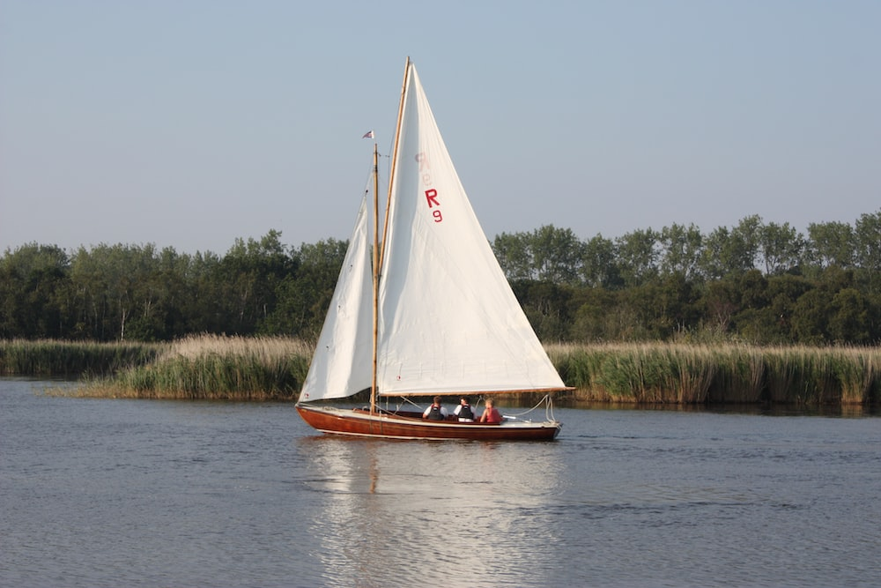

Introducing the new Youth Early Support Service (YESS)!
YESS TO PROGRESS
County-wide offer for 10–18-year-olds.
Early intervention and support
We will recognise young people as experts on their own lives
Over 70 young people were involved in designing our programme
Our support will predominately be based in schools
Notes:
We are currently launching the new service that has replaced Norfolk Connect.
YESS operates county-wide predominately in schools with additional support in the community where required. Supporting young people aged 10-18 by providing early intervention, reducing the requirement of more intensive support needs in the future.
Delivery is in 2 programmes!
Programme 1 is our lighter-touch transition support programme for 10-13 year olds. This programme will predominantly be delivered to year 6 students supporting their transition into year 7 at high school. It will be a group work programme that responds to concerns year 6s have as well as providing them with peer-mentoring skills to support other young people as they move through their secondary-school career.
Programme 2 is closer aligned to the previous Norfolk Connect service. We will work with 14–18-year-olds, to understand what they are struggling with and co-produce actions and support plans to help them overcome barriers and worries before they present as a significant risk for that young person.
Just to be clear about how we work. We will recognise young people as experts on their own lives, and coproduce programmes of support with young people as equal partners.

Slide 7



THANK YOU!
For further information or to make a referral, Email: YESS@prospects.co.uk
Notes:
Referral
Lets take a deeper dive into how we deliver the Yess programme. You will see we are continually getting feedback from our yp, parents and schools.

Slide 8
Youth Concerns Consultation
Top 5 biggest concerns
1 | School - Attainment / grades / exams | 15%
2 | School - General | 14%
3 | Mental Health and Wellbeing | 10%
4 | Relationships and Friendships | 10%
5 | Future - World of Work / employment | 7%
Notes:
Locally every year we carry out a consultation with the yp we work with, to find out what concerns them the most.
From this we check with our colleagues to make sure we have relevant training to support them.
1- From this survey we will be having standing agenda point on our team meetings to include, how we support yp in organising their time to fit in homework and studies. Good and bad practice
2- We feel we always ask them how things are going in school and give them time to talk about incidents that might be on their minds.
3- Mental health and well being was already on our agenda- as it also came up high on last years survey. This has lead to sharing of training that some of us took up, to sharpen our own awareness and skills. We have also imposed some mandatory courses ie Trauma informed practice and Youth Mental Health first aid
In the previous year this survey identified a need for training around supporting yp who have lost a relative and how to support yp with suicidal ideations

Slide 9

Initial meeting
Notes:
We try to meet the yp at their home first with a parent, so we can give them an idea of the programme. We may also do this with the referrer, as a warm handover.
We also try and get parents/carers buy in as well.
Plus it is also an opportunity to get an idea of their homelife and living circumstances. It is really useful to talk about confidentiality with the adults present, so they understand what we will report back and what we won’t. How often have parents tried to ask us about what the yp said about them? This way if they do ask, we can refer them back to this conversation.
The buy in of support from family can be really important, they can very often use our meeting of an encouragement to getting them in school. Also having set the parameters and having some sort of rapport, you already have broken the ice, in case of a serious disclosure or just a simple bit of work in repairing relationships between yp and family. We all know yp don’t feel listened to and sometimes we can either be their voice or even better support them to have a voice.

Slide 10

Contract with Young People
Confirm Programme Information (Overview of programme)
Optional Engagement (They do not have to take part)
No Secrets (If we believe they are at risk of harm, or putting someone else at risk of harm, we will tell someone).
Timeline (How long will you provide support for? how often will you see them? where?
Reason For Referral (Why were they referred, and what do you hope to achieve?
Assessments (explain the resilience compass and co-produced action plan)
Consent (Taking into account the information they have been given, do they want to work with you?)
Tasks to move forward (What happens next? Agree any actions)
Notes:
So locally our service sets up a contract with YP, when we first start working with them., usually in the school we start with covering this: CONTRACTR sounds quite foirmal, but it is just a framework to make sure we cover everything. I personally make it more informal and treat it as a fluid conversation. Lets TALK THRU CONTRACT

Slide 11
Resilience compass
Notes:
The assessment is our own copyrighted Resillience Compass.
It covers 4 areas MY lifestyle, MY relationships, Myself and My future. We can map the results on them on this paper version of the compass, to help our visual learners to understand. However, we normally use a smart survey to get the results.

Slide 12
Resilience compass contd
Notes:
This and all our evaluations/surveys are set up on Smart survey.
We can record individual surveys by down loading them and storing the results on our database to compare their journey. Our service manager also uses these to give evidence of KPIs to our commissioner.
As a company we are in process of moving over our surveys to MSForms. You will see an example of this in the chat, when we ask you for feedback on this session.
Beware if anyone is using Survey Monkey. It is not GDPR compliant, and you may wish to think about changing.
When carrying out the assessment, I also hand them a laminated card with a scaling of 1 to 5 and answers from It never happens-1, nearly never happens- 2, sometimes happens – 3. Nearly always happens -4 and Always happens -5. They can answer on either scale. This again helps different yp with different learning styles to engage in the assessment. Let’s look at the questions a bit closer.

Slide 13
Resilience compass contd..
Notes:
As usual we all have our preferred way of working some workers will complete the survey and then ask follow up questions around the lower scoring replies to see where we can support them. I prefer to do this as we go along. You say potato, I say banana.
Once we have completed it online, it gives a score out of 100. we also talk about what that means and how we will do this exercise again in about 8 weeks/visits time- to see how things have changed. Hopefully there will be an increase in it, but bare in mind it is like an MOT, The score can be affected by something that has happed that day and they might feel less positive. Also we have to be wary sometimes on the first session they want to please us, or not have a low score- so sometimes we do it again a few weeks later to get a truer result.

Slide 14
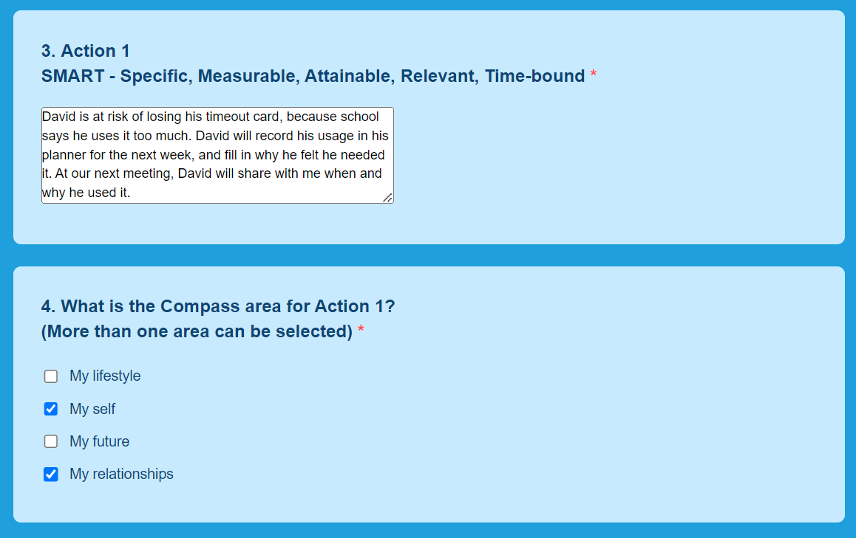
Referrals, CONTRACT & Assessments
Notes:
Any way From the results of the Compass, we identify areas that we can work on with the yp. for example:
They may have scored low on “ I take responsibility for my actions”- Then in conversation we might talk about possibly losing his “Time out card” because school say he is using it too much. So we set an action plan about how he can record his usage and see if he is justified to use it, or if it was an occasion that he did not really need to. This way he can start taking more responsibility for his actions and hopefully next time he does the compass, he will score higher.

Slide 15
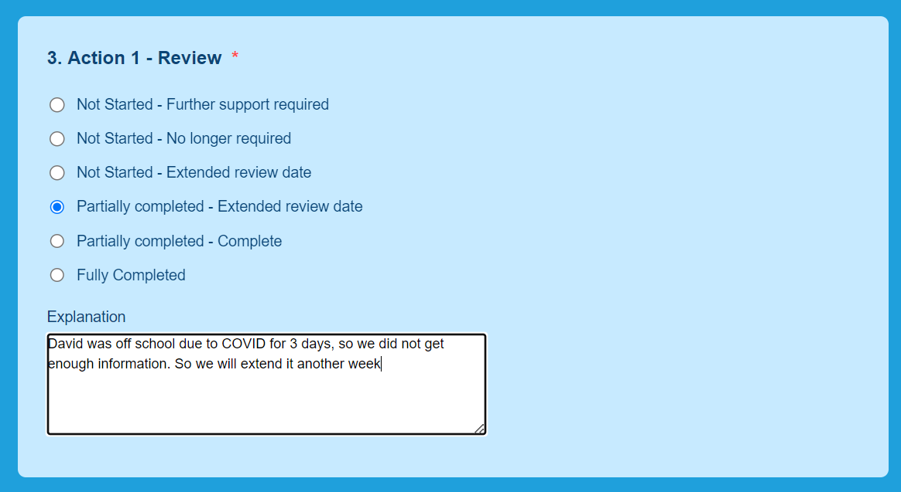
Action plans
Notes:
In real life things can get in the way, so we might have to extend the action plan to a new review date. Or even start completely again. Life changes and we must be flexible in our approach. I have regularly completely started again, as their life has suddenly got new priorities.

Slide 16







Some of the evaluations we use……….
Notes:
Most of these surveys are be filled in by the yp. However, we have options for parents, teachers, activity providers to fill in slightly adapted questions, to report back on results they have seen. Again great evidence for commissioners etc.
I am not going to bore you by showing you every example, but they are pretty easy to set up and adapt so that the questions are relevant and read right to the person filling it in. For example to the yp, it would be phrased “did you enjoy the activity?” If a parent was filling in the same question it might read “ Do you feel they enjoyed the activity” The provider might be asked “Did the yp appear to enjoy the activity” etc.

Slide 17
Does it work?
Last quarter, 98% of young people we supported in Norfolk said that their youth worker listened to them and understood their worries- June 2023
Last quarter, 81% of young people we supported in Norfolk said that they have developed resilience and other skills which helped them make positive changes. June 2023

Slide 18
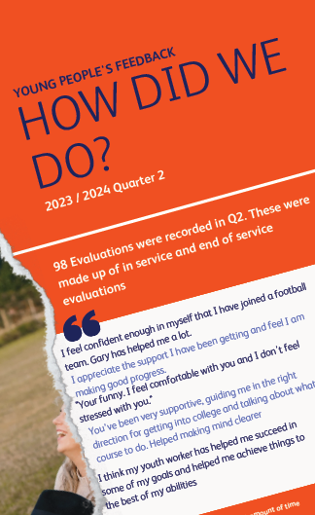

Survey results
Notes:
This came out today, and reflects the new service

Slide 19

Over to you…..
Notes:
So how can you utilise your own client's expertise in the delivery and design of your own service?
We are going to break into rooms, so you can discuss ways that you can get your clients buy in, by using their expertise in the delivery of your service? Or share what you already do, as we are also experts in our own areas and can share good practice
When we return, could someone from each group feedback an example of good practice or ideas you might use? You have 10 minutes.

Slide 20

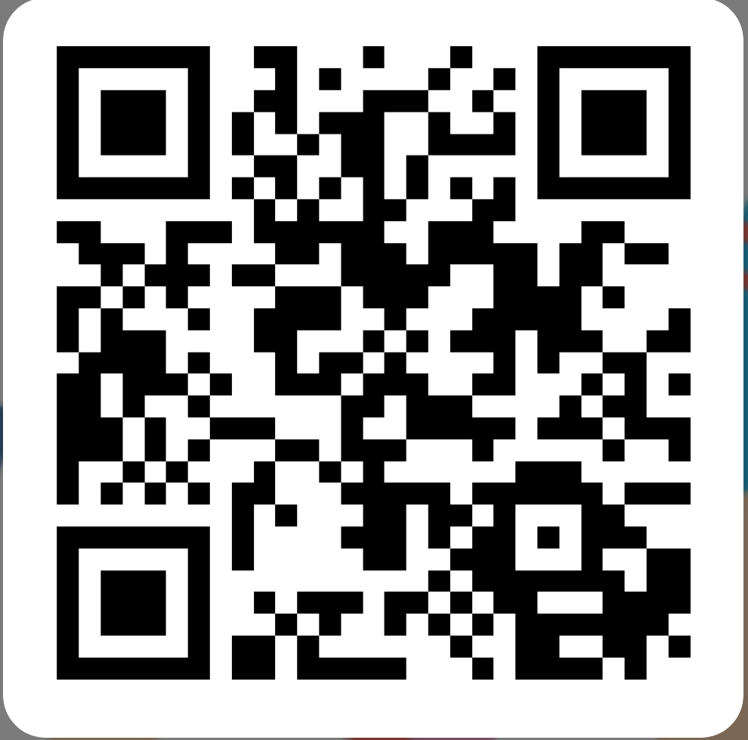

Please let us know what you think
https://forms.office.com/e/nFDzqZWk4i
Notes:
Presenters, please copy this link into the chat to request feedback:
https://forms.office.com/e/nFDzqZWk4i

Slide 21
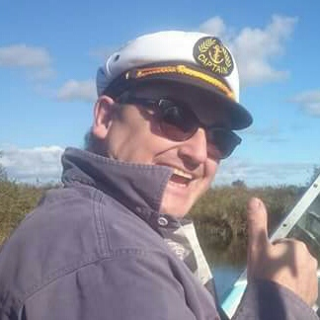

Email: Micheal.Pepperell@prospects.co.uk
Referrals to:
yess@prospects.co.uk

