Slide 1

Honour Abuse
Forced Marriage: Briefing for Education Professionals
These materials have been devised by Kelly Waters, Adviser – Education Safeguarding, in partnership with Amanda Murr, Briefing and Development Officer, Norfolk Constabulary.
Notes:
Please ensure that you are familiar with the content of the resources and associated Government guidance before delivering the session. It is advisable for you to access the on-line learning tool provided by the Home Office to ensure you have a full understanding of the issues: https://www.fmelearning.co.uk/login/index.php
Please note this is an important but difficult topic to discuss. You must ensure that you support staff appropriately by advising on the distressing nature of the content before commencing the briefing and by making yourself available at the end of session for staff to talk to you on a 1:1 basis.
Begin the session by showing staff one of 3 short films produced by the Foreign & Commonwealth Office: https://www.youtube.com/playlist?list=PL31AFBCDD3F40EF3E
Honour Based Violence is inadequately understood. Honour abuse can be distinguished from other forms of abuse as it is often committed with some degree of approval and or collusion from the family and or community members.
Between mid-July 2010 and the end of May 2014, 63 incidents of honour based abuse have been reported to Norfolk Constabulary, of these 11 were reports of potential forced marriage and two reports of forced marriage.
Further details can be found here http://www.norfolk.police.uk/safetyadvice/personalsafety/honourbasedabuse.aspx

Slide 2

Association of Chief Police Officers Definition
‘Honour based violence’ is a crime or incident, which has or may have been committed to protect or defend the honour of the family and/or community’.
Notes:
Honour killings, forced marriage, domestic abuse and female genital mutilation are not isolated practices but are instead part of a self sustaining social system built on ideas of honour, cultural, ethnicity and religious superiority.
As a result of these ideals, every day around the UK women and some men are being threatened with:
physical violence,
rape,
mutilation,
abduction,
false imprisonment,
withdrawal from education
and forced into marriage by their own families and/or community because of the belief a victim has dishonoured their family or community. In extreme cases their death is arranged or sanctioned by the family.
This is not a one time problem of first generation immigrants bringing practices from other countries to the UK. Instead honour based violence is now to all intents and purposes, an indigenous and self perpetuating phenomenon which is carried out by third and forth generations who have been raised and educated in the UK.
Brandon and Hafez 2008
Abuse in the name of honour cuts across individuals from all cultures, nationalities, faith groups and communities and has no geographical boundaries.

Slide 3
Offences
Murder
Threats to kill
Inflicting physical injury – assaults
Child Destruction, Procuring a miscarriage
Theft
Blackmail
Kidnap
Abduction of Child
Sexual Offences Act 1956 - Rape, indecent assault, rape of a child under 13
Harassment
Stalking
Threats to destroy, damage criminal property
Perverting the course of justice
Forced marriage
Female genital mutilation
Breaching Non-molestation Order, Forced Marriage Protection Order
False Imprisonment

Slide 4
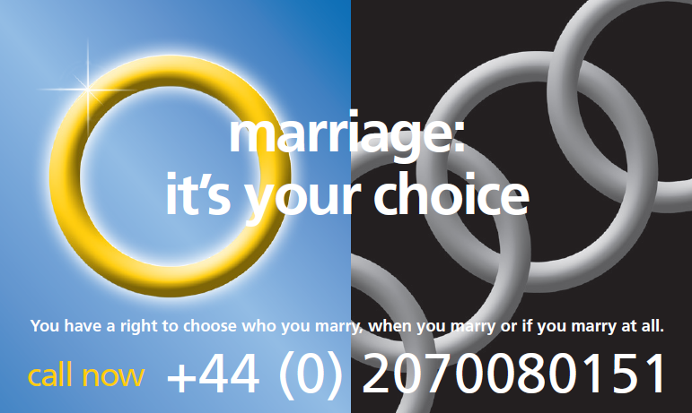
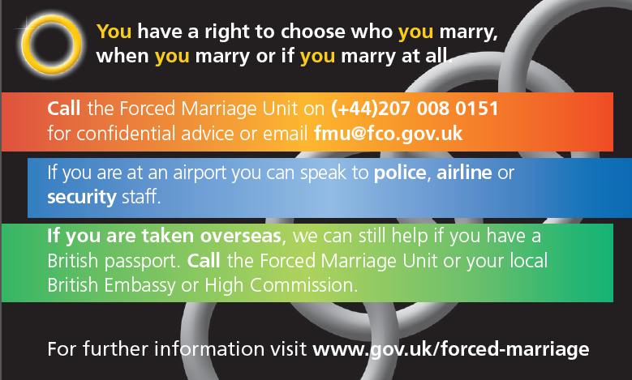
Marriage:
Arranged or Forced?
Forced Marriage Facts
Primarily an issue of violence against women.
Most cases involve girls and women aged between 11 and 40 years.
Evidence to suggest 15% of victims are male.
In some cases victims do not know they are subject of forced marriage; they are brought up to believe this is the norm.
Not just a South Asian problem .

Slide 5
Forced Marriage
A forced marriage is a marriage where one or both people do not (or in the case of some people with learning or physical disabilities, cannot) consent to the marriage and pressure or abuse is used.
The Anti-Social Behaviour Crime and Policing Act (2014) has created two new offences of forced marriage. These new offences will come into effect on 16 June 2014. The Act also makes it a criminal offence to breach a Forced Marriage Protection Order (FMPO) to further increase protection for victims and ensure that perpetrators are properly punished.
The civil remedy of obtaining a Forced Marriage Protection Order through the family courts will continue to exist alongside the new criminal offence, so victims can choose how they wish to be assisted
There will be a maximum penalty of seven years for committing a forced marriage offence and a maximum penalty of five years for breach of a forced marriage protection order.

Slide 6
Forced Marriage?
What the law says - Offence of forced marriage:
A person commits an offence under the law of England and Wales if he or she:
uses violence, threats or any other form of coercion for the purpose of causing another person to enter into a marriage, and
believes, or ought reasonably to believe, that the conduct may cause the other person to enter into the marriage without free and full consent.
practises any form of deception with the intention of causing another person to leave the United Kingdom, and
intends the other person to be subjected to conduct outside the United Kingdom if the victim were in England or Wales.

Slide 7
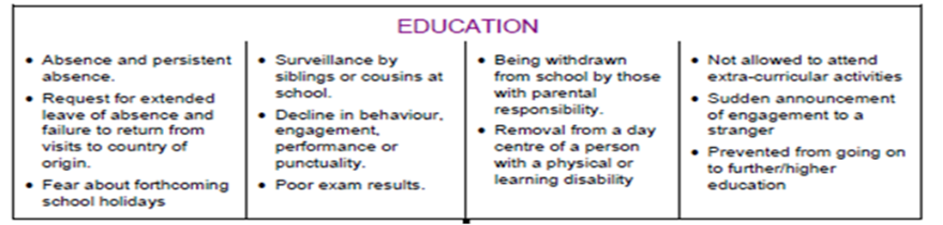
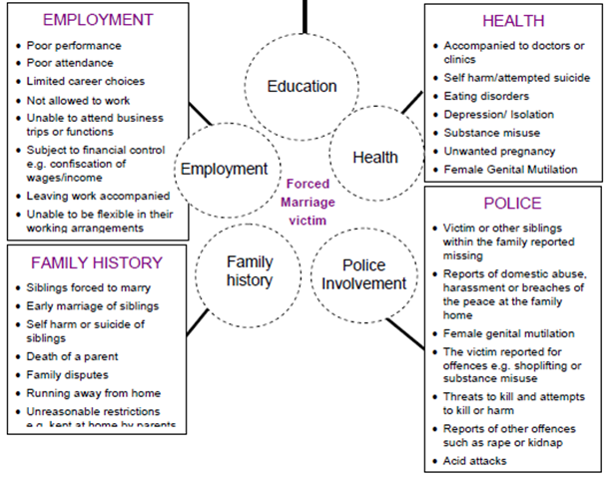
Forced Marriage: Potential Warning Signs
Notes:
‘Quick Think’ Exercise: Ask the group to try to identify some potential indicators of Forced Marriage before showing the chart.
The indicators are taken from ‘Multi-Agency practice guidelines: Handling cases of forced marriage’, HM Government (2014). Please provide staff with the risk and indicators checklist provided with this pack.

Slide 8
The warning signs of forced marriage can include:
Victim or other siblings within the family reported missing or running away from home
A history of older siblings leaving education early and marrying early
Absence from school, fear of forthcoming school holidays, decline in behaviour, becoming withdrawn from school, removal from day centre care and prevented from going on to high education.
Suddenly announcing engagement to a stranger.
Depressive behaviour including self-harming, attempted suicide, eating disorders, substance misuse and early unwanted pregnancy
Unreasonable restrictions such as being kept at home by their parents (“house arrest”) or being unable to complete their education
Reports of domestic abuse, harassment or breaches of the peace at the family home
Death of a parent
Female genital mutilation
The victim reported for offences e.g. shoplifting, substance misuse or burglary
Threats to kill and attempts to kill or harm
Reports of other offences such as rape or kidnap
A person always being accompanied including to school and doctor’s appointments.
Employment difficulties such as poor performance, poor attendance, limited career choice, not being allowed to work unable to be flexible in work arrangements and always being accompanied to and from work.

Slide 9
Barriers for reporting Honour Based Violence/Abuse
Disownment/Ostracised from community being labelled Dishonourable
Displacement/isolation/identity
Fear of being found – bounty hunters, reprisals
Lack of information and access to services available to help – key to minors
Lack of awareness of HBV /A by those in authority

Slide 10
Key Principles - Forced Marriage
If families have to resort to violence or coercion to make someone marry the persons consent has not been given freely and therefore it is considered a forced marriage
Where a person lacks capacity to consent to marriage, an offence is also capable of being committed by any conduct carried out with the purpose of causing the victim to marry, whether or not that amounts to violence threats or any form of coercion.
One Chance Rule
One chance to speak to the victim or potential victim
One chance to save a life from abuse
Be aware of your responsibilities and obligations when dealing with forced marriage.

Slide 11
Forced Marriage Unit
A joint-initiative with the Home Office offering confidential advice and assistance to:
those who have been forced into marriage
those at risk of being forced into marriage
people worried about friends or relatives
professionals working with actual or potential victims of forced marriage.
Telephone: 020 7008 0151
www.gov.uk/forced-marriage
Notes:
This service provides advice and guidance for British nationals being forced into marriage overseas. The Unit also provides expert advice to professionals, especially those confronted by it for the first time.

Slide 12
If you are concerned about Forced Marriage
Don’t:
Send the victim away
Ignore what the student has told you or dismiss out of hand the need for immediate protection
Underestimate the perpetrators of HBV – they DO kill their closest
Approach the family or community leaders
Share information without the consent of the individual - if you do have to, discuss with them
Attempt mediation / use family as interpreters
Assume it is a racial/cultural issue/faith issue
Assume someone of a similar ethnic origin is best to deal with such a case

Slide 13
If you are concerned about Forced Marriage
Do:
Believe the victim
See the victim alone/consider their wishes (vulnerable not able to make logical decisions)
Give reassurance of the victims confidentiality
Gather as much information from the victim as possible
Follow your child protection procedures and talk to your Senior Designated Professional without delay in order to get support from other agencies

Slide 14
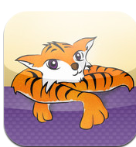
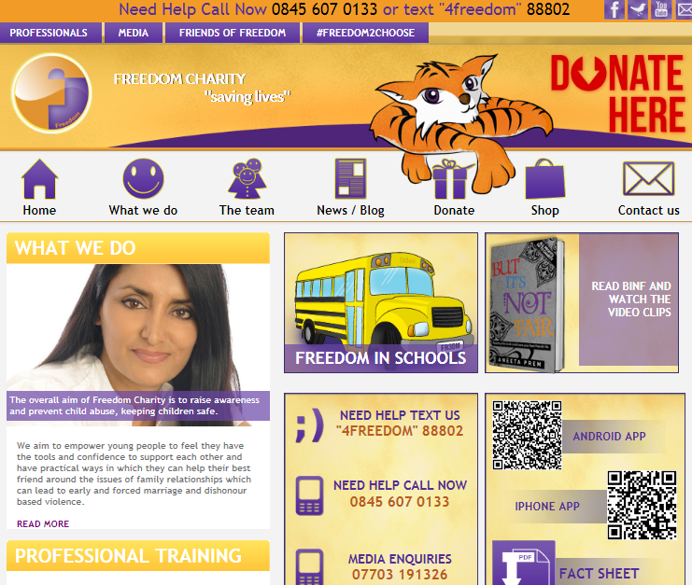

Freedom Charity
24/7 Helpline - 0845 607 0133
Text – ‘4freedom’ to 88802
Notes:
Promoted by the FMU, the organisation http://www.freedomcharity.org.uk/ has produced a very clever app that offers help, assistance and instruction to children, friends of children, professionals with an interest and any other parties.

Slide 15
Further Support
If you have concerns that a child is at risk you should contact Norfolk MASH and/or Norfolk Constabulary without delay:
MASH: 0344 800 8020
Norfolk Constabulary: 101 or in urgent cases dial 999
Karma Nirvana Honour Network Helpline – 0800 5999 247
IKROW – Iranian & Kurdish Women
Forced Marriage Unit
Southall Black Sisters
Women’s Aid
NSPCC Asian Helpline
Health, Research & Development (FORWARD)
The African Well Women’s Clinic (AWWC)
MASH partner agencies
All agencies are listed in the back of the FM and FGM Guidance documents
Notes:
Freedom Charity offering help, assistance and instruction to children, friends of children, professionals with an interest and any other parties. Looking at HBA/FM and FGM.

