Slide 1



Welcome
Welcome!
Please be aware that some of the sessions are being recorded for sharing later.
We want people to participate but please use the ‘raise hand’ facility to ask questions and contribute when others are talking.
Please be considerate to others - together we want to create a safe, open and reflective space to learn.
You can turn on live captions on by clicking on the 3 dots at the top of your screen if you need this.
The link to the feedback form will be put in the chat.
Please do take the time to complete it after the session.
Thank you!

Slide 2

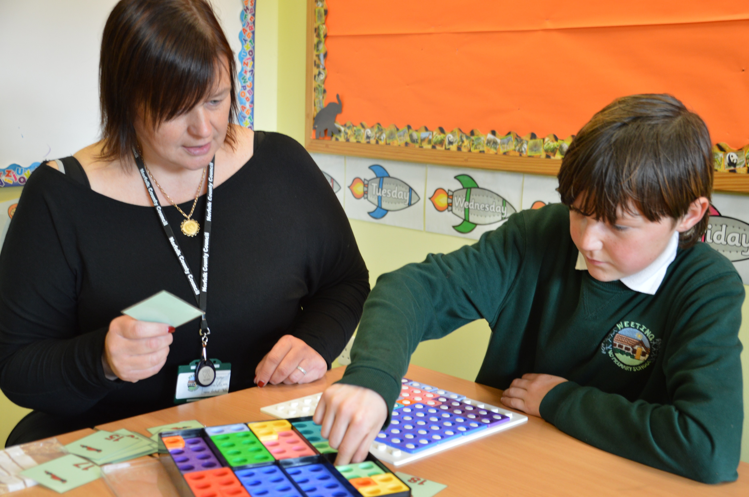
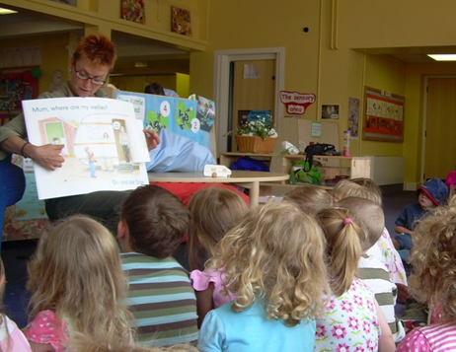

Working With Gypsy Roma Traveller (GRT) Families and Communities GRT Service Inclusion and Opportunity
Hilary Heath, GRT Team Manager
Claire Tattersall, Specialist GRT Practitioner
Rachel Yates, Specialist GRT Practitioner
Cindy Campbell, GRT Community Liaison Officer
Notes:
Claire – I do the same role as Rachel, we are Specialist Gypsy, Roma Traveller Practitioners, working 1:1 in schools. I work in Norwich South & East and Rachel works in King’s Lynn, West and Fens. We have a third practitioner, Corri, who does the same role with a Secondary focus.
Hi, I’m Rachel Yates and our role is to work with pupils in school who are highly mobile with significant periods of missed or fragmented education, aiming to narrow the gaps in their learning, this includes SATS and GCSE support. In addition, we support mental health and wellbeing, including retention, engagement and transition.

Slide 3
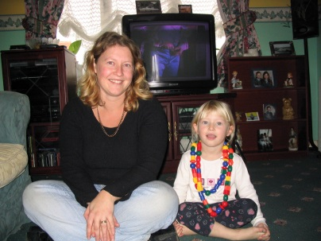
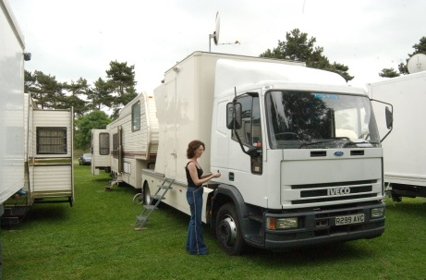
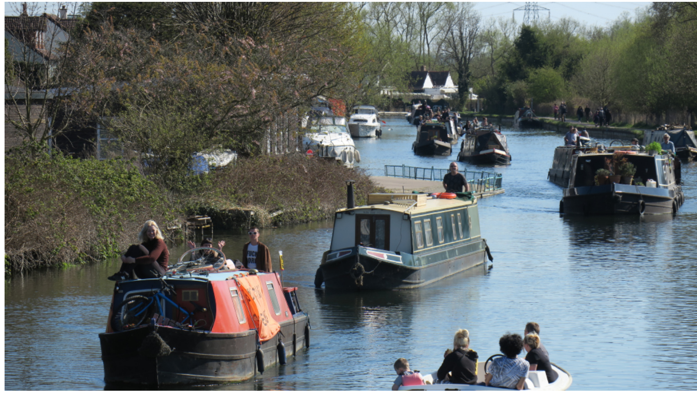
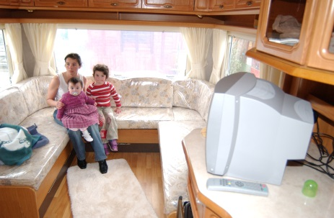
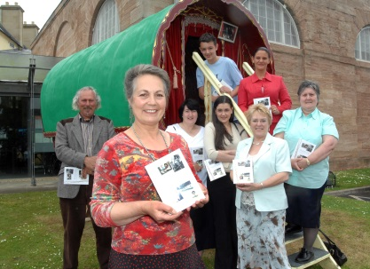

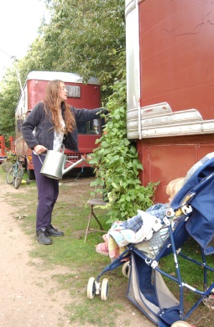
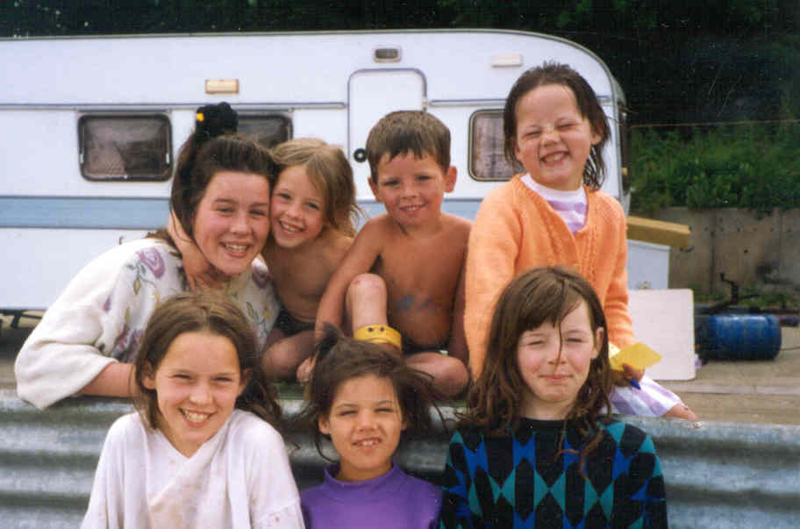
Who are our Gypsy Roma Traveller Children?
Showmen
Bargee or Boater
Gypsy
Housed
Gypsy Roma Traveller
Communities
Scottish
Roma
Circus
New Travellers
Irish Travellers

Slide 4
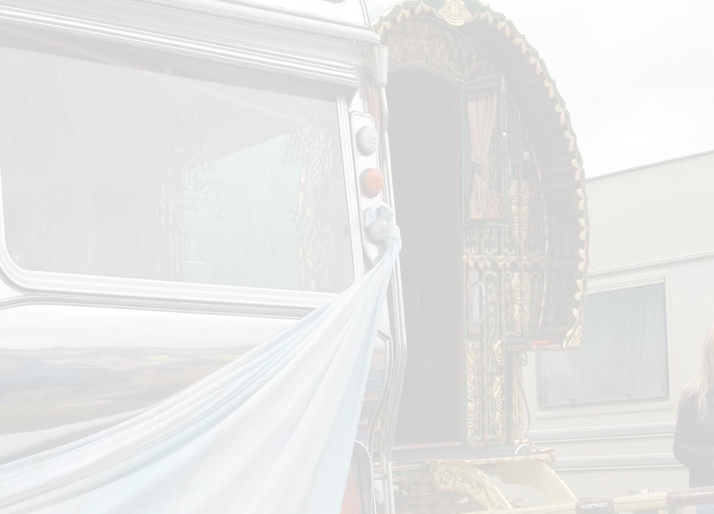
GRT Community Liaison Officers work with families and communities
Social Care, EHAPs and FSPs
Admissions
Family & Community
Attendance
Exclusions
Notes:
Admissions – We offer our support in accessing school places for new families moving into Norfolk and families moving around Norfolk. We complete online application for the families where there might be literacy issues. This can be the start of the relationships that we will build with the families.
From there we offer support with a visit to the new school, we will also support with school forms and paperwork and accessing the online Apps, being mindful that not many Gypsy Roma Traveller families are digitally aware or literate either. texts and WhatsApp works but not school platforms or Apps. The families can have lots of questions about starting in school, and sometimes need reassuring that their boy/girl will be kept safe.
Attendance- As I have said we work closely with the families to build a trusting relationship and, over the years, we have become a trusted service for GRT communities in Norfolk. This means when we need to, we can sometimes have those difficult conversations with the families we work with. One of those conversation can be attendance, explaining that the local authority requires children to attend 100%. Alongside this, however, GRT families can use the T code in recognition of their ethnicity and the need to travel for work.
Exclusions – No Parent wants their child to be Permanently Excluded, the GRT pupils have a higher rate of permanent exclusion and fixed term exclusions compared to any other ethnic group. This says a lot about their experience, relationship, and engagement with the education system. As a team these are all areas that we work to improve for our GRT Children and young people in school. We work closely with schools and the families to avoid GRT Children being Permanently Excluded If there is no alternative, we support the families by attending PEX meetings and, where needed, the Appeal process. At the point at which the child is referred to the Short Stay School For Norfolk we will work with the setting and family to facilitate a smooth transition.
Social Care Gypsy Roma Traveller families tend to turn to their relatives and community members for support related to social care; Social Care services are often feared by these communities, the main fear being that their children will be removed. This is where our under pinned knowledge of the culture, community and their values, really helps We are there to support the families work alongside Social Workers for Child in Need Child Protection Joint Agency Group Supervision or Multi Agency Risk Assessment Conference and anything we may need to be involved in to make the process more accessible and less stressful for the family. We will keep that work going alongside schools and Family Practitioners when and if the cases are dropped down to Early Help Assessment Plan or Family Support Process.

Slide 5


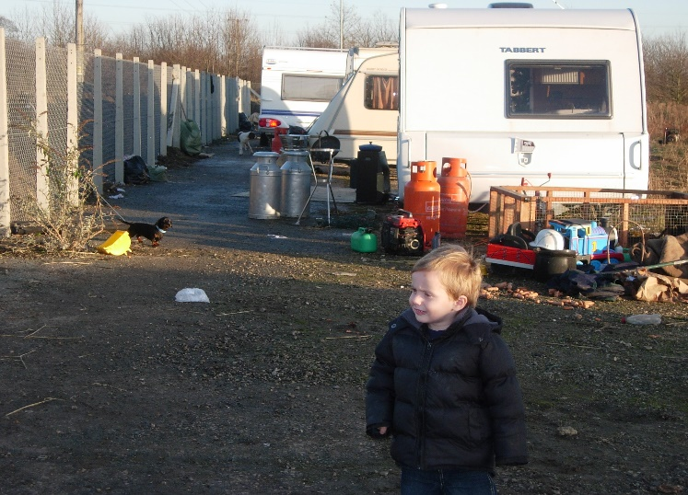
GRT Service - Early Years and Health
Notes:
Work in Primary Schools
123 Primary schools with GRT children attending
Service working directly with 30+
Criteria for SGRTP support with GRT children
Support for GRT families going through EHCP process
GRT and RSHE curriculum
Online tutoring programme
GRT EYFS and Primary Network
Cultural Awareness Training
Lateness considerations/literacy/use of CLOs/establish contact and emergency contact numbers

Slide 6

Working With Gypsy Roma Traveller (GRT) Families and Communities GRT Service Inclusion and Opportunity

Slide 7
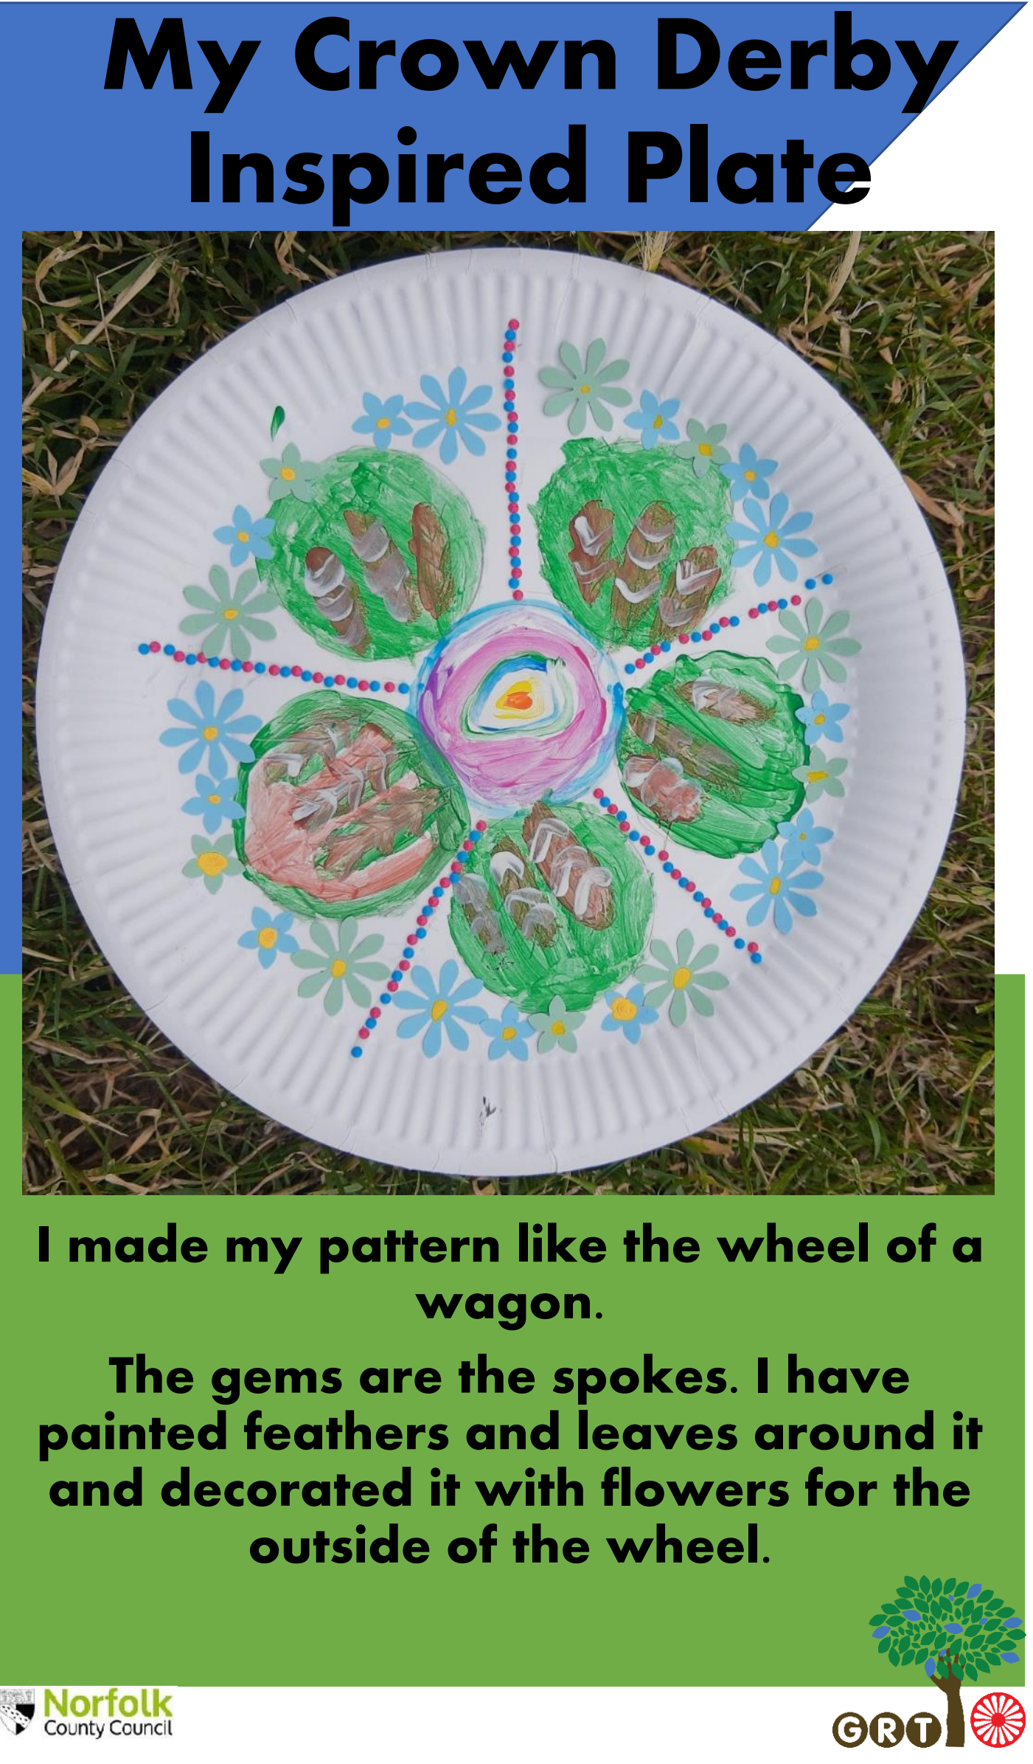
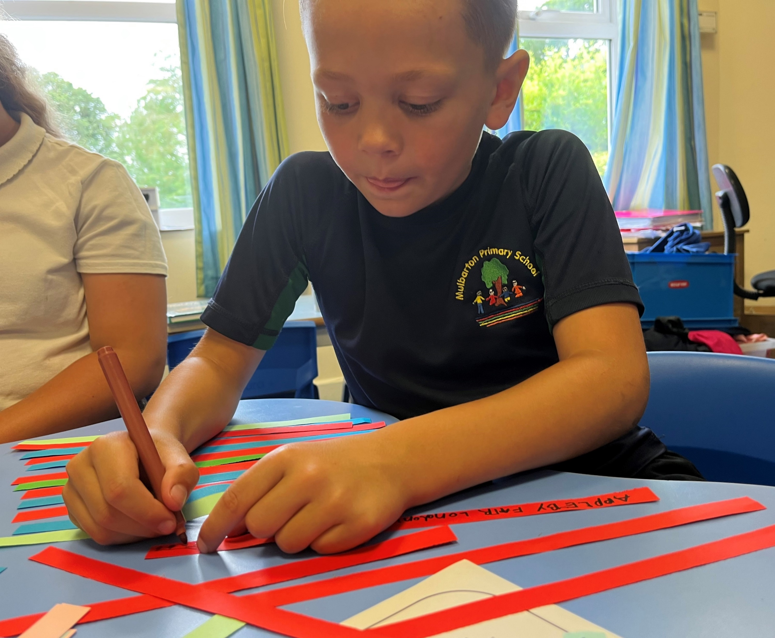
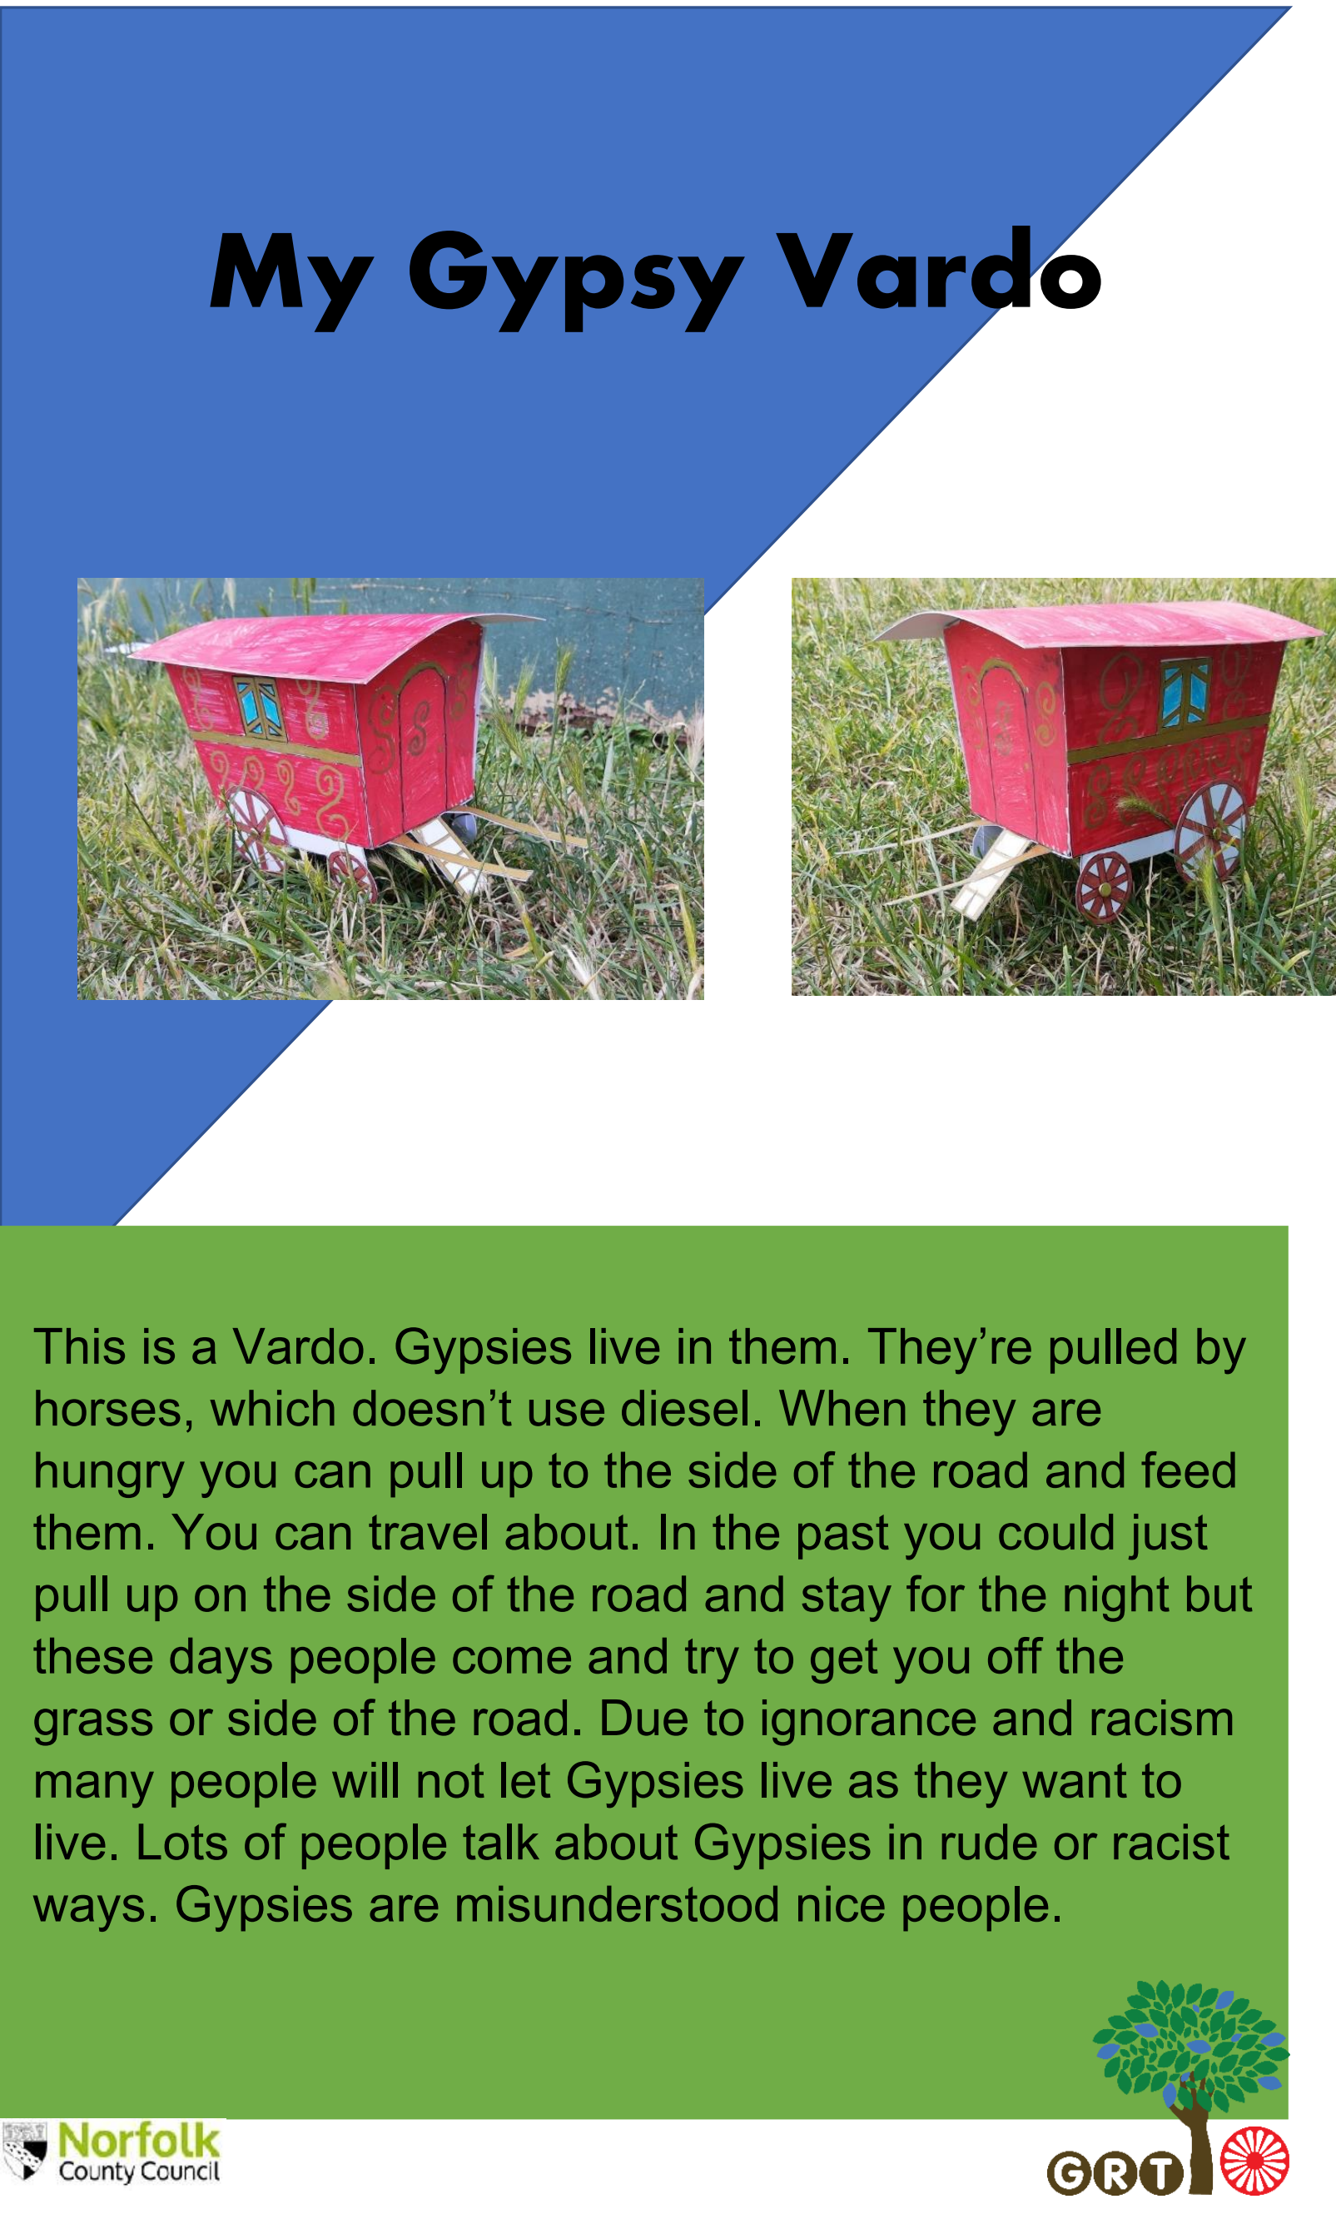
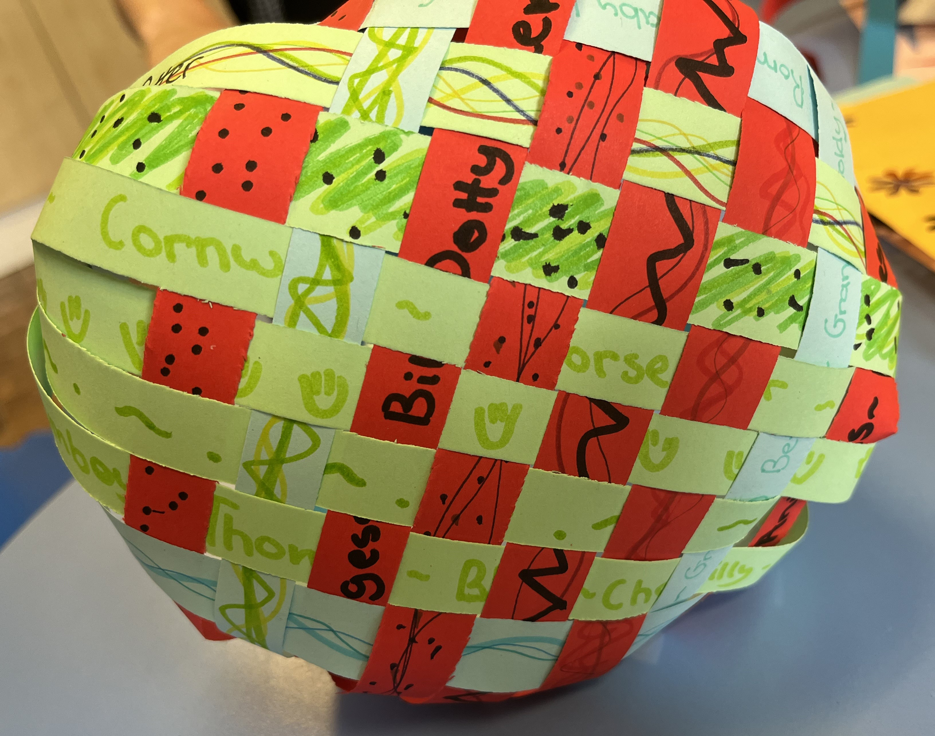
GRTHM 2023 in Primary Schools
Assemblies
GRT Website: https://www.schools.norfolk.gov.uk/pupil-needs/gypsy-roma-traveller
Notes:
Primary: We used this year’s theme of Weaving Journeys as a starting point but the children in each school took it in their own direction depending on their focus and interests. In one school they hadn’t celebrated history month in a few years. I had only worked with 1 of the pupils previously but during history month we worked with the whole cohort. The sessions brought the cohort together in a safe way and allowed them to talk openly about aspects of their lives that they didn’t usually discuss at school. The boys spent hours with Lego – building their Dad’s vans, adding tools and really exploring the elements of their culture and lives that are important to them. They were the experts, teaching me about Scrap metal and the ins and out of the industry that they were learning from their Dads. As a group they talked together about who they are, what is important to them, but also about the stereotypes they have come across and how that made them feel. One person even told me that their family had changed their name in the war so that they wouldn’t be recognised as Gypsies to keep them safe. Together they created a display highlighting the positive aspects of their culture and as it was going up they were proudly bringing their friends to come and see what they had been making. They were teaching their peers about a part of themselves that isn’t always seen or shown. The animation and pride in their voices as they talked about their Crown Derby designs, their Vardos and their history was amazing. Different pupils and schools celebrated this in different ways. In some schools we worked on activities such as weaving – a craft and skill that used to be a way that many roadside families used to earn their living. They would forage for materials, weave the baskets and then sell them in villages as they passed through. These days that skill is classed as a heritage craft and is dying out. We used it as a chance for the children to weave together their dual cultures – their family heritage (Gypsy, Roma or Traveller) alongside their school culture. By helping the children to feel that all parts of their lives are valued and respected it builds self-confidence, pride, respect for themselves and others and teaches those around them to respect the lives of people who may have differences to themselves.
Rachel - In two schools where we worked on GRTHM, the pupils were keen to do an assembly. They planned this themselves from the activities we had done over the month. They did the assembly in front of the whole school, parents were invited, and senior leaders came too. The pupils confidently spoke about their culture, their families and traditions and they showcased their work. All of the pupils enjoyed taking part and were very proud to have their parents, grandparents, aunts, uncles and cousins in school to see what they had been doing.

Slide 8

GRT History Month (GRTHM) 2023
Every June since 2008, people from across the UK have celebrated Gypsy, Roma and Traveller History Month.
Through celebration, education and raising awareness, Gypsy, Roma and Traveller History Month helps to tackle
prejudice, challenge myths and to amplify the voices of Gypsies, Roma and Travellers in wider society.
Gypsy, Roma and Traveller History Month 2023 - Friends, Families and Travellers (gypsy-traveller.org)
Weaving Journeys: A celebration of Gypsy, Roma and Traveller lives, histories and cultures”, an exploration of the rich nomadic histories and heritages of Romany Gypsy, Roma, Irish Traveller, Showmen, New Traveller and Boater communities of Great Britain.
In Weaving Journeys, we explore the places Britain’s nomadic communities have been in the past and present, and where new paths could lead in the future.

Slide 9

GRTHM Meets FLOURISH
child voice
“I live on site, close to others in my family. I love living there because I get to see family every day and I can learn about how we cook and clean and take care of each other ”
L
F
“They used to cook on a fire. You have 3 sticks and a rope or chain. Then you hang your kettle on it and hunt for food.”
“My favourite part was making the basket because I got to write and draw about my family and where I travel.”
“'Gypsies can live in trailers, caravans, houses and mobile homes, they will still be a Gypsy because it is their ethnicity.”
“I am proud to be a Gypsy because I am different to non-Gypsy people and I can tell them about my way of life and they can learn we are interesting and nice.”
O
U
R
I
S
H
“Before she used to hide the fact that she is a Gypsy but now she is open and proud.” (teacher)
“I felt really scared to speak but once I got started it was good”
GRT Website: https://www.schools.norfolk.gov.uk/pupil-needs/gypsy-roma-traveller
Notes:
Norfolk aims to be a county where all children and young people can flourish.
Much of the work we do in schools supports this ambition and here we have some child voice quotes from our work over history month. We would just like you to take moment to read these and see how you feel they link to the impacts of FLOURISH.

Slide 10
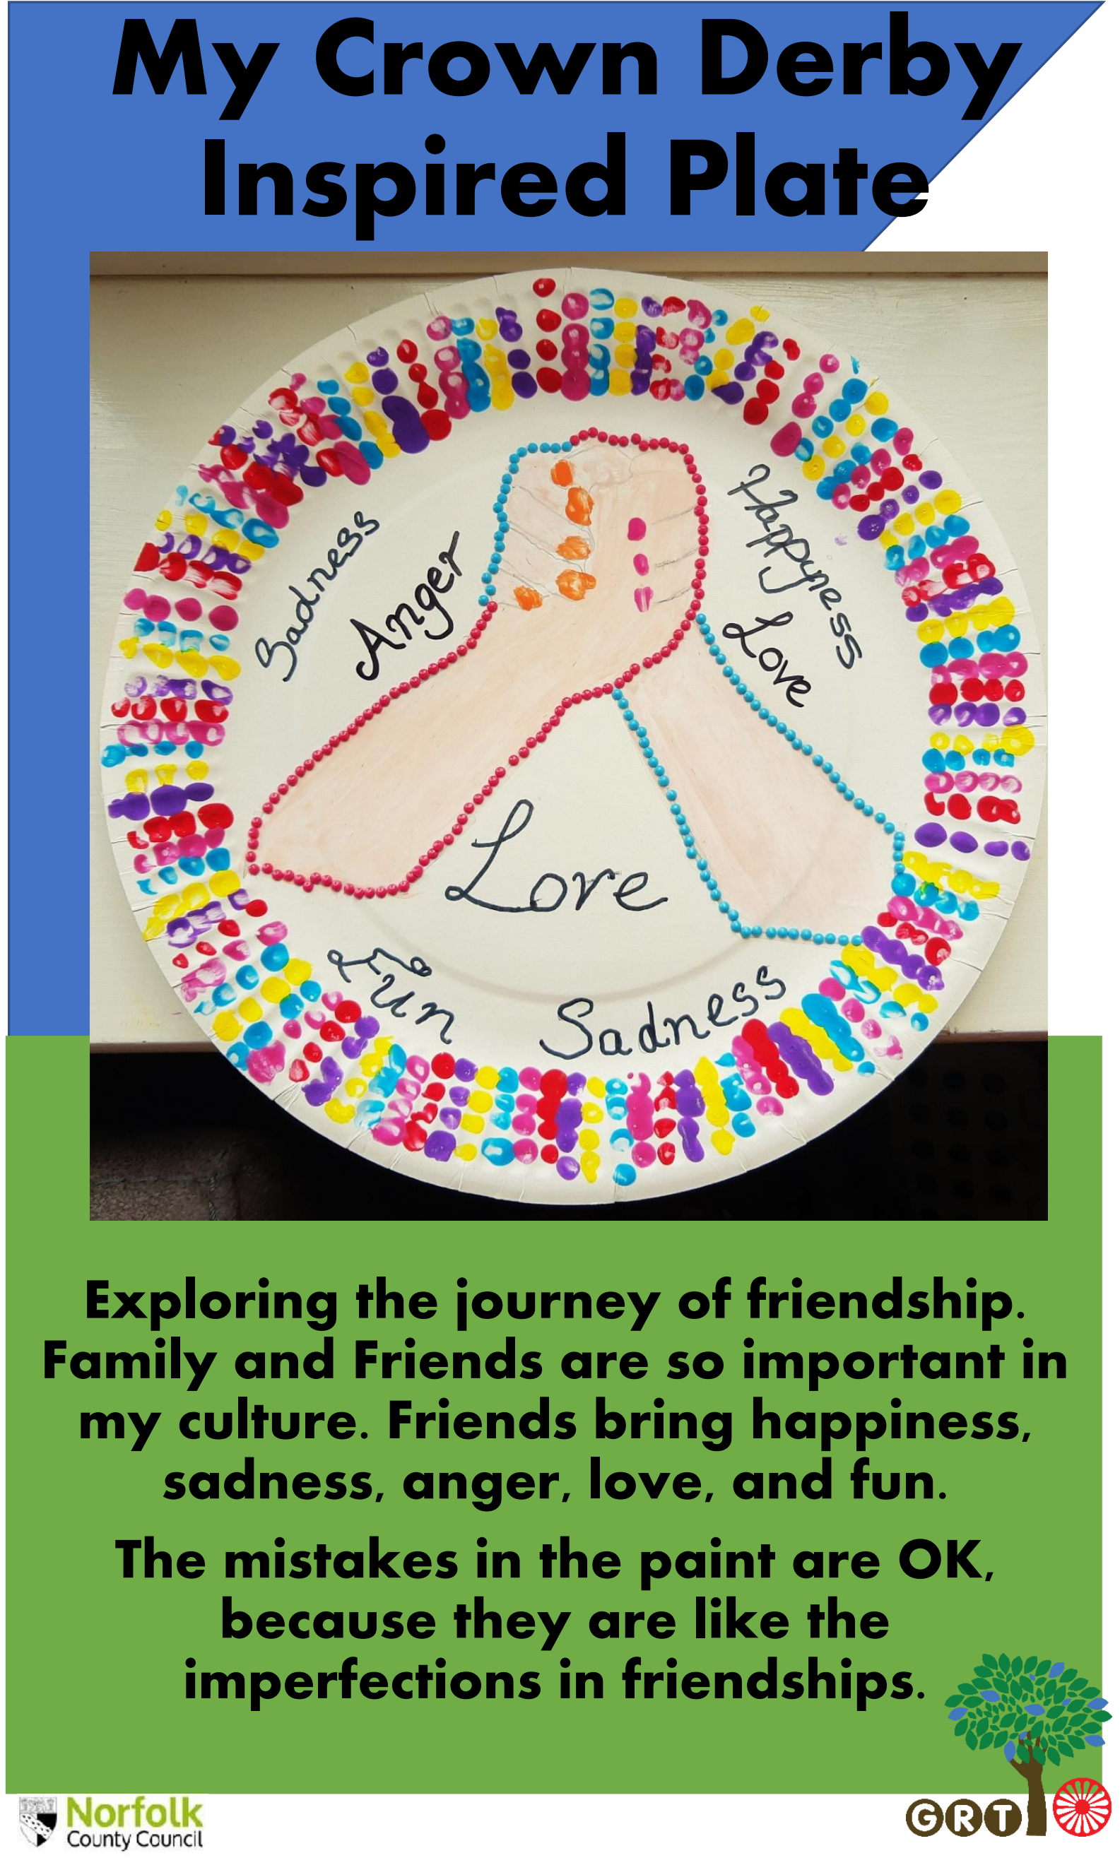
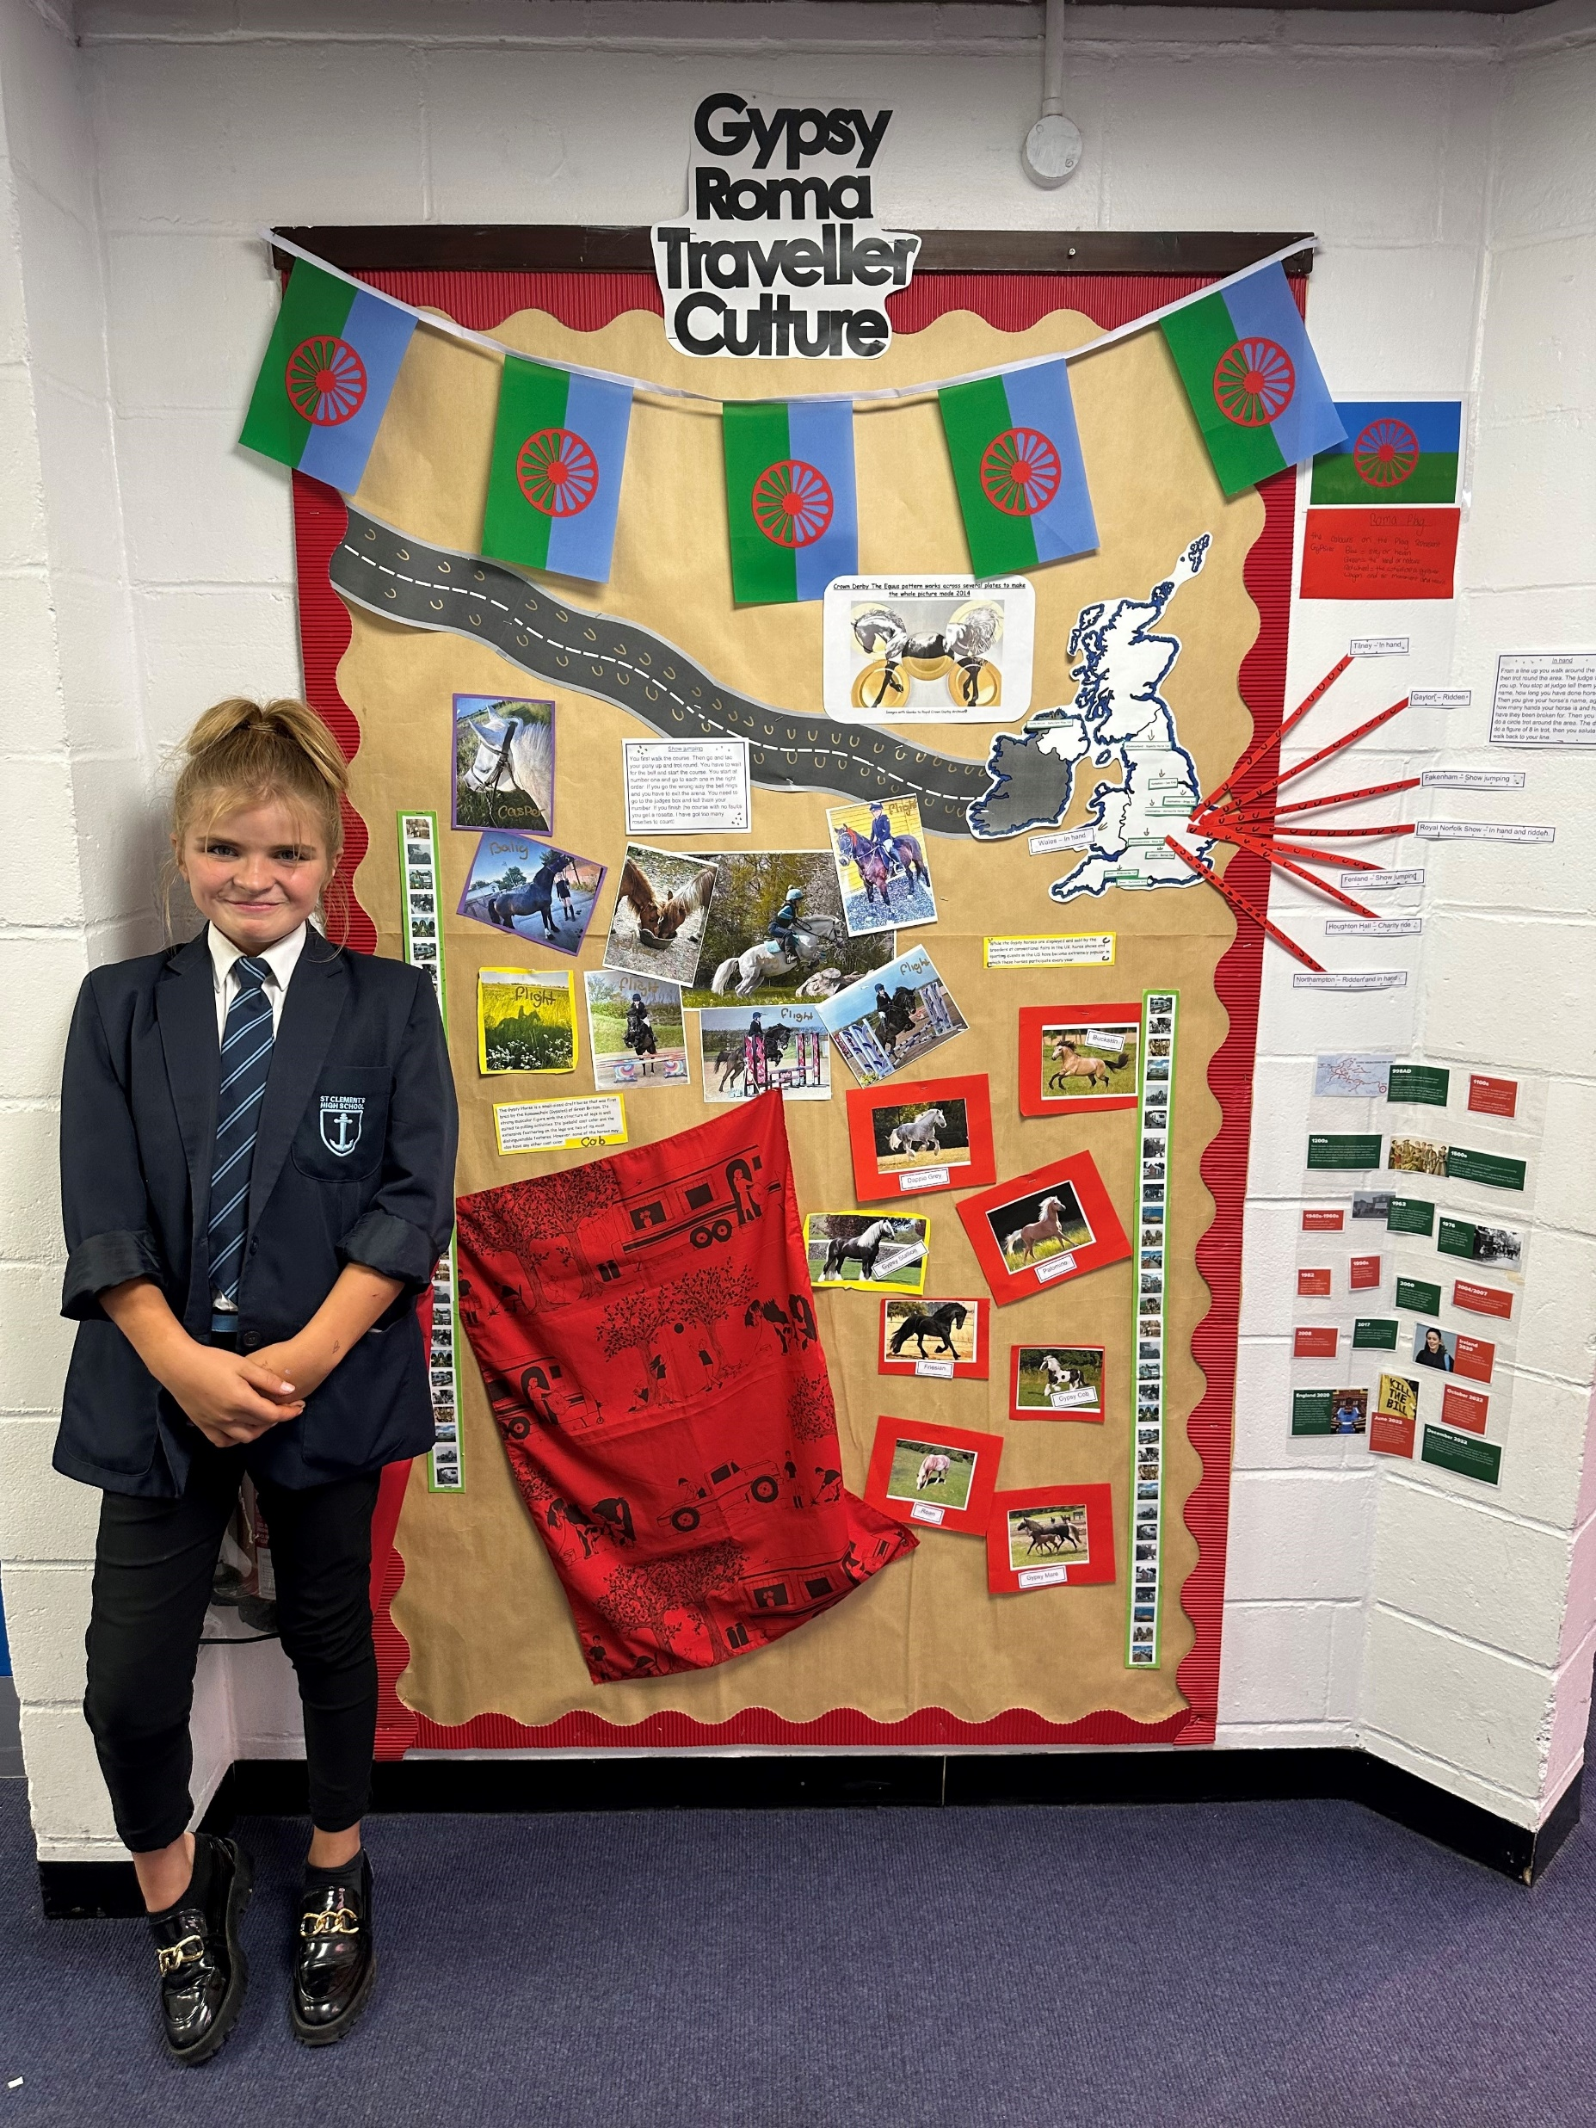
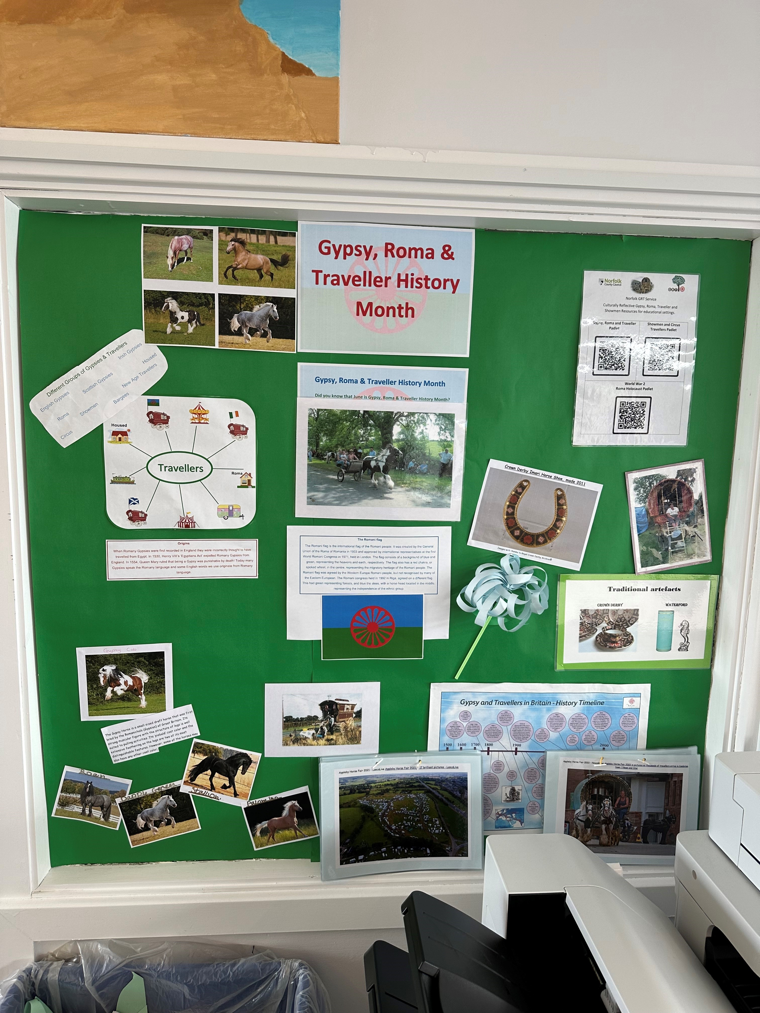
GRTHM 2023 in Secondary Schools
GRT Website: https://www.schools.norfolk.gov.uk/pupil-needs/gypsy-roma-traveller
Notes:
Rachel – the photo on the left shows a students display. She was very reluctant to take part in GRTHM but as we had been working hard on her literacy, she was willing to explore the resources and research further into GRT history and culture. The display took her lead and included everything she wanted, from making paper flowers to building a timeline of significant historical events. From not wanting to be seen to be putting up the display, by the end of the month she took her friend to show her the work she had been doing with me.
The photo on the right is of a student who had been very disengaged with school and wanted only to spend her days with her horses. The theme of weaving journeys linked perfectly for her to tell me about the places she had travelled for horse fairs and showjumping. She became motivated and focused, plotting these places on the map and displaying photos of herself and her horses, writing details of their breeds, unique markings and colours. She has become very proud of the display and the fact that other students and staff in school have stopped to look at the photos on display and showed an interest by asking her questions about it.
Claire - This student didn’t want to take part in GRTHM to begin with but then she chose to join in with the FFT annual competition. She chose to focus her design on friendships as this is an area that we work on together in our sessions. From talking through her ideas, she chose to participate more in history month and by the end of June she had created her own display in her cloakroom to share with her friends

Slide 11
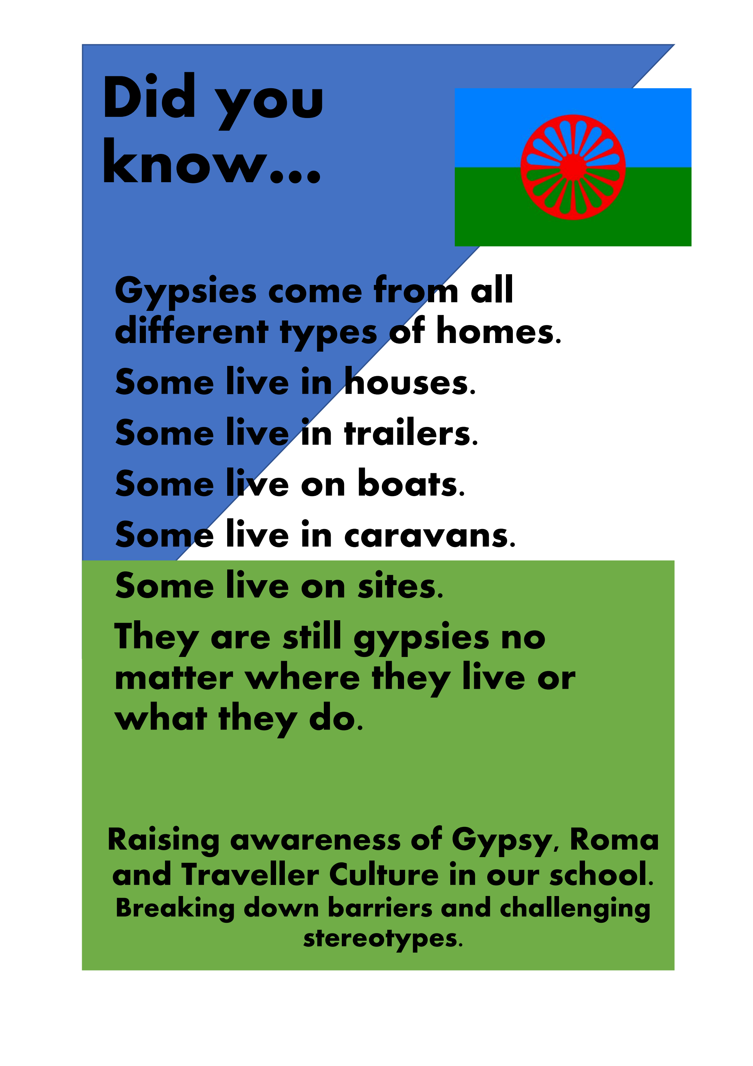

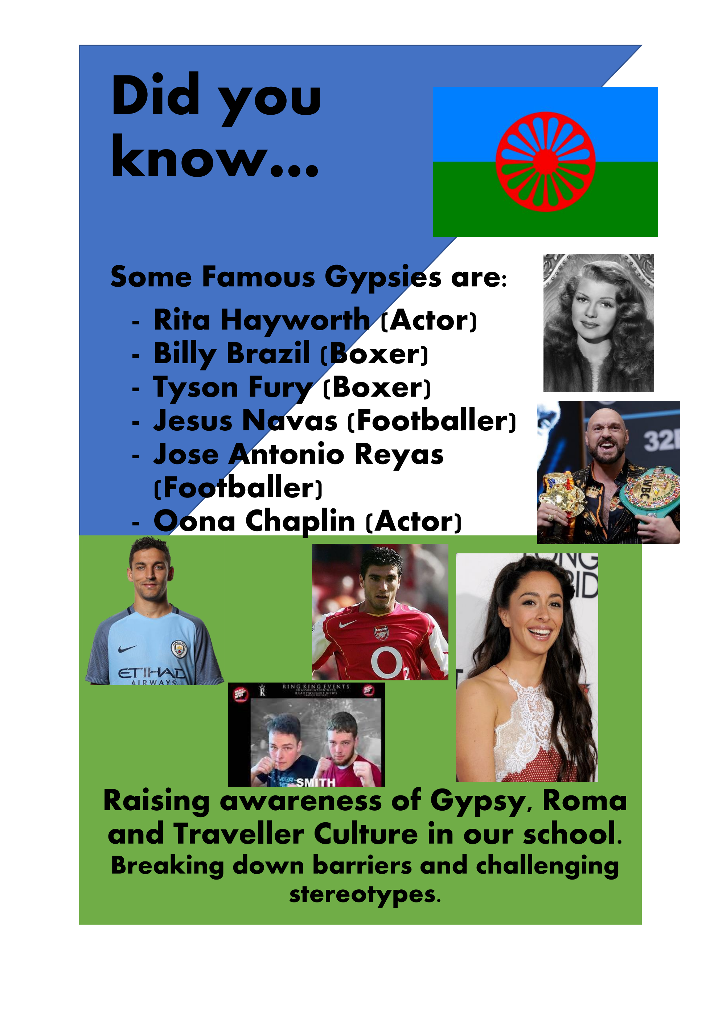
GRTHM 2023 in Secondary Schools contd.
GRT Website: https://www.schools.norfolk.gov.uk/pupil-needs/gypsy-roma-traveller
Notes:
GRT Champion – Over the month of June one of my pupils went from not wanting to interact much with History month, to wanting to put up her own display in school – where it would be seen by as many people as possible. By the end of the month she wanted to make posters to go around school too. Her aim was to break down stereotypes and to teach others in the school about her culture. From this the school asked if she would like to be a GRT Champion. She made posters for each of their cloakrooms with topics that she felt people misunderstood about her Gypsy culture. One stereotype that she really wanted to teach people about was that just because she lives in a brick house doesn’t mean she isn’t a Gypsy anymore. She told me about people not understanding that she is still a Gypsy no matter where she lives. It is a part of who she is.

Slide 12
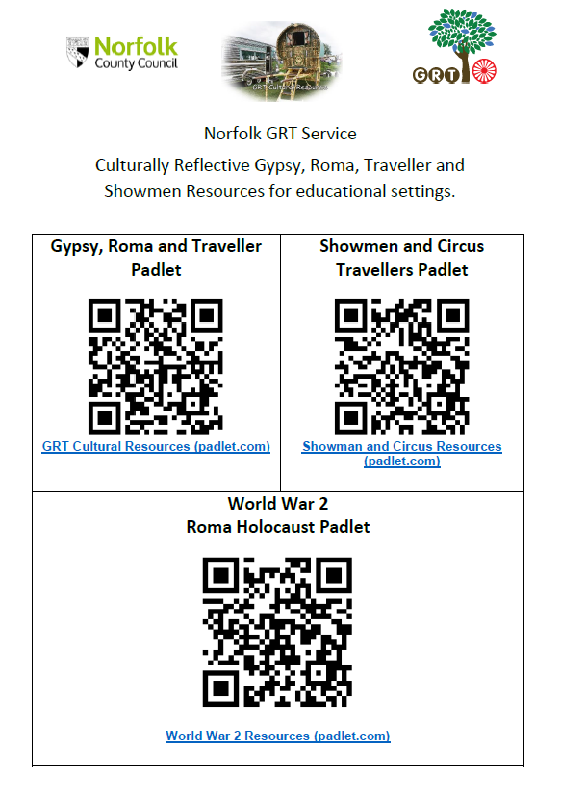
GRT Culturally Reflective PADLETS
The GRT Service have produced three Padlets with the aim of offering schools the opportunity to enhance the diversity content of their teaching and learning by embedding GRT history and culture into their curriculums.
For more information contact Claire Tattersall:
claire.tattersall@norfolk.gov.uk
GRT Website: https://www.schools.norfolk.gov.uk/pupil-needs/gypsy-roma-traveller
Notes:
The GRT Service have produced three Padlets with the aim of offering schools the opportunity to enhance the diversity content of their teaching and learning by embedding GRT history and culture into their curriculums.
The project began with our World War 2 Padlet – Teaching people about the ‘Forgotten Victims’ of the war. Between 250-500,000 Roma were killed in the war. These resources are made to help teachers embed this information into teaching about the Holocaust that is already taking place. There are resources that allow teachers to link learning to Anne Frank, Photo packs, timeline resources.
The GRT Cultural Padlet enables teachers to embed GRT Culture into more areas of the foundation stage curriculum – such as DT (Moving Vehicles), Geography – Homes, Travelling patterns, Music – Gypsy Swing, Flamenco, and also Mental Health and Wellbeing – the facts and figures are ones that all educators and people working with young people need to know – to be able to support pupils and young people in a proactive way, rather than reactively enabling them to Flourish.
The Showman and Circus Travellers Padlet enables teachers to teach about the distinct communities within our GRT umbrella term. Showmen and Circus Travellers have very different history to Roma, Gypsies and Irish Travellers. Embedding their culture into areas such as Art and History are ways to celebrate these differences. There are also resources to support themes such as Black History month –e.g. Pablo Fanque.
The Padlets have been built in collaboration with teachers from schools but also members of the community. Community voice is so key and we want to be representing them as they would like to be represented. This is a growing resource.

Slide 13
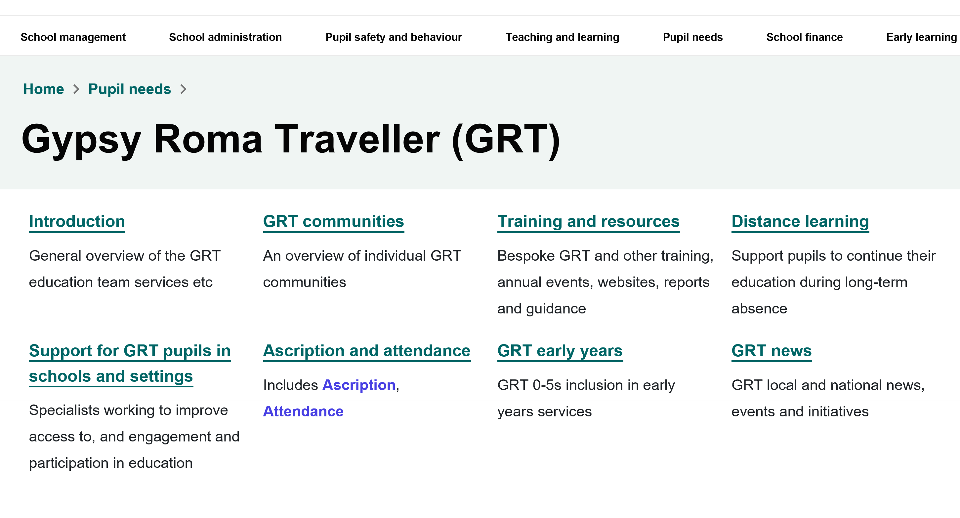
GRT Norfolk Schools Website Overview
GRT Website: https://www.schools.norfolk.gov.uk/pupil-needs/gypsy-roma-traveller

Slide 14
Working With Gypsy Roma Traveller (GRT) Families and Communities GRT Service Inclusion and Opportunity
Any Questions?
GRT Website : www.schools.norfolk.gov.uk/pupil-needs/gypsy-roma-traveller
Notes:
hilary.heath@norfolk.gov.uk
claire.tattersall@norfolk.gov.uk
rachel.yates@norfolk.gov.uk
cindy.campbell.norfolk.gov.uk

Slide 15

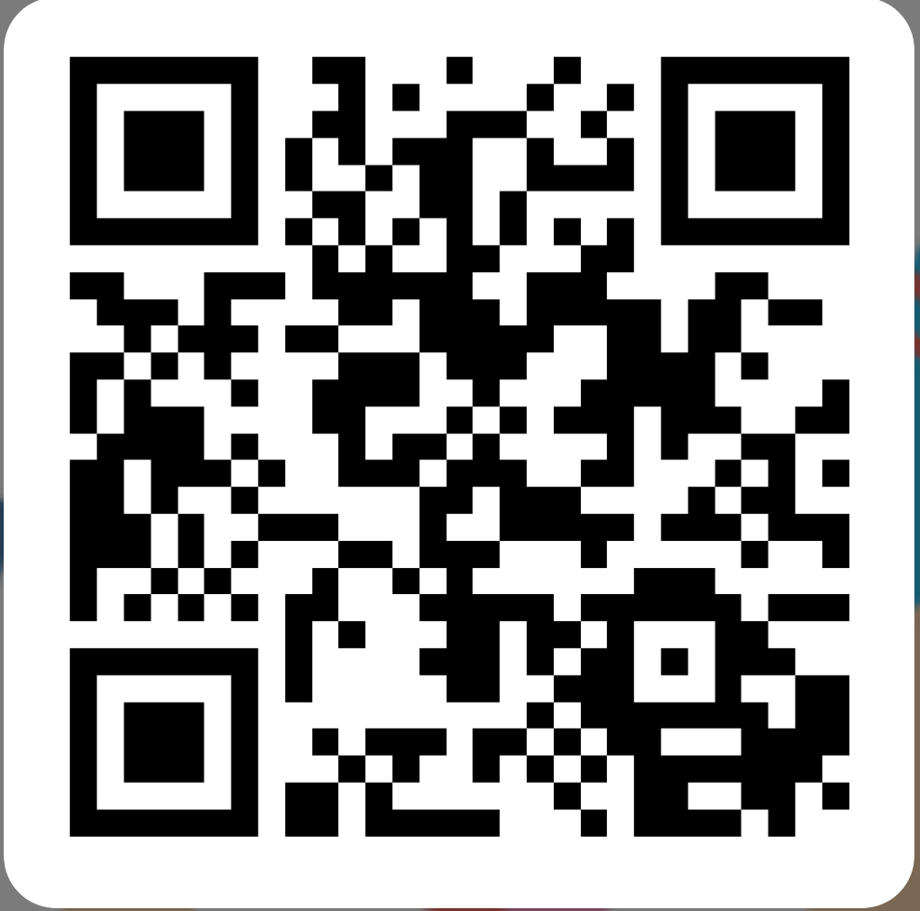
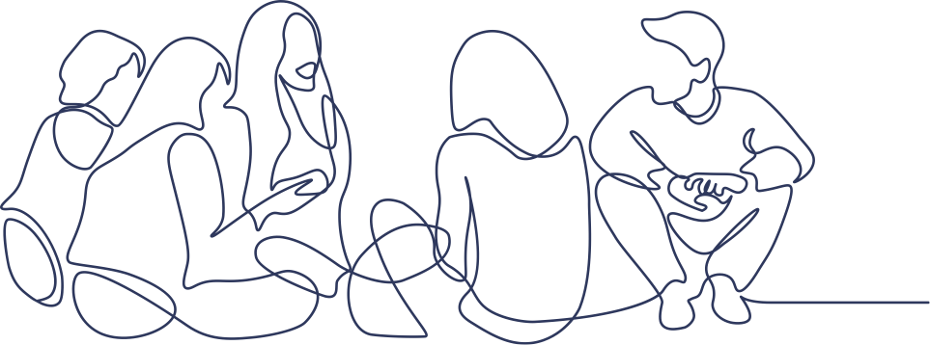
Feedback form
Please let us know what you think
https://forms.office.com/e/nFDzqZWk4i
Notes:
Presenters, please copy this link into the chat to request feedback:
https://forms.office.com/e/nFDzqZWk4i

