Slide 1
SEND Friendships
The Benjamin Foundation
Specialist Short Breaks
Angela Teague
Marcia Frony-O'Shea

Slide 2
welcome

Slide 3
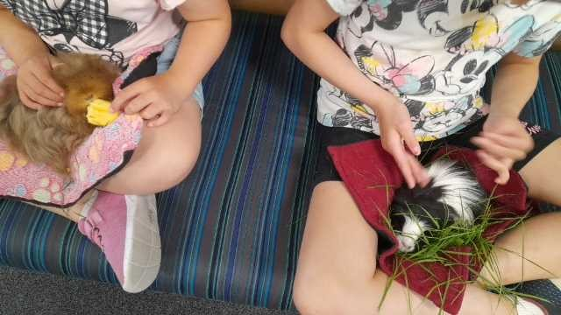
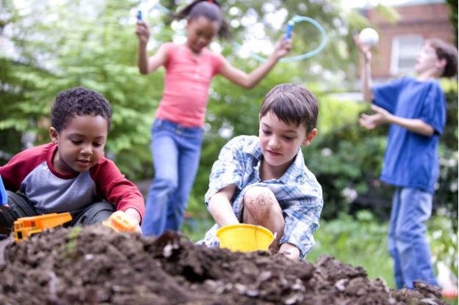
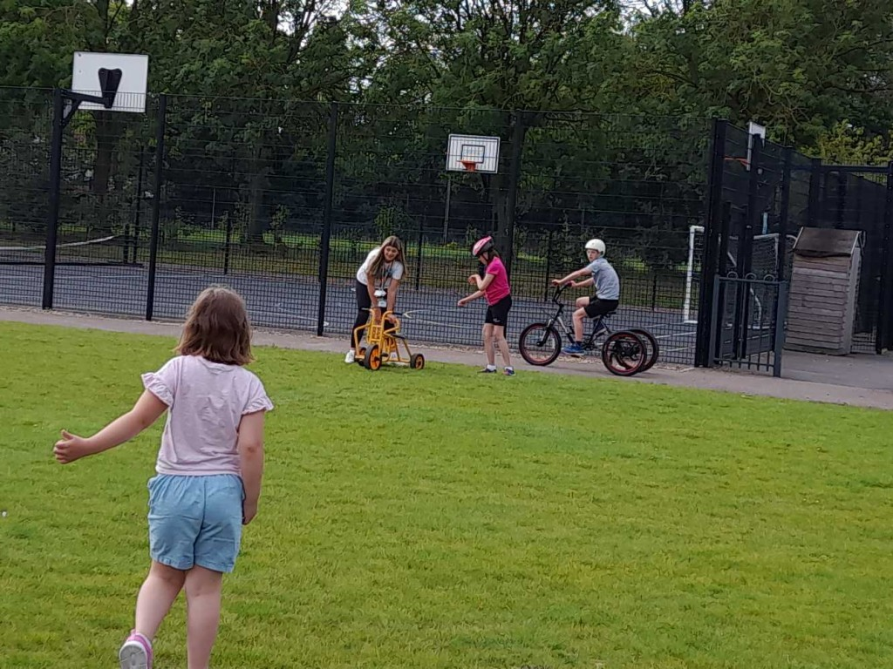
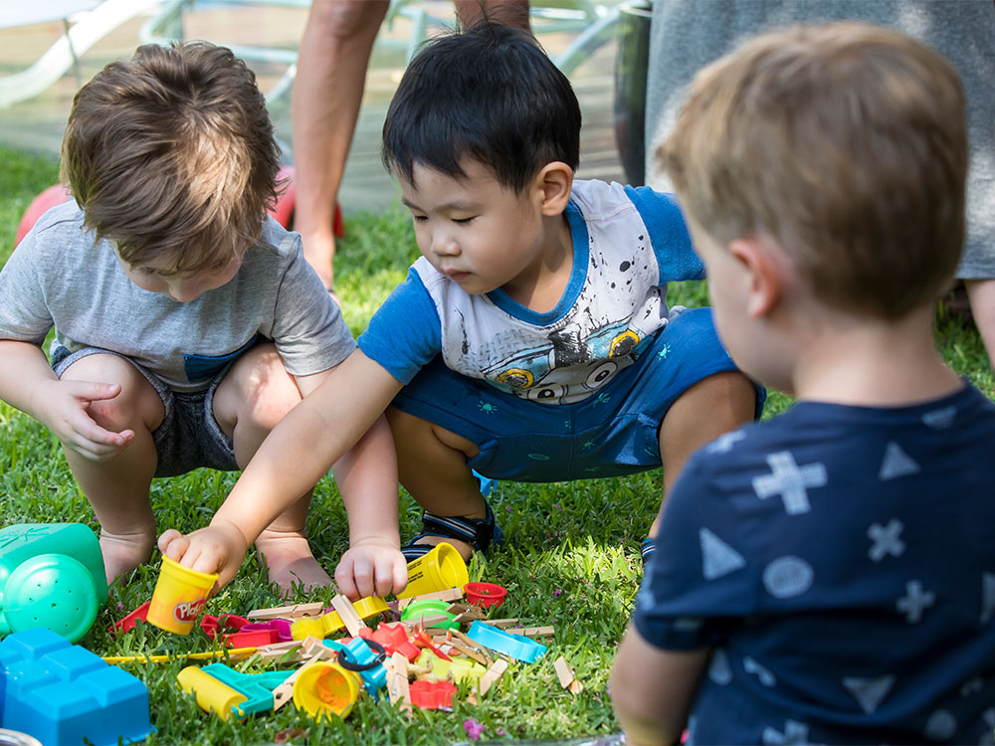
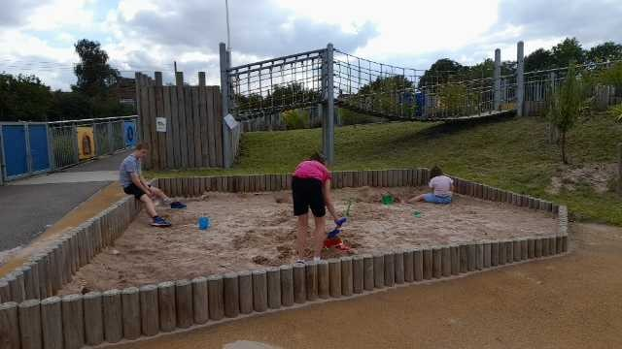
Friends and friendships

Slide 4
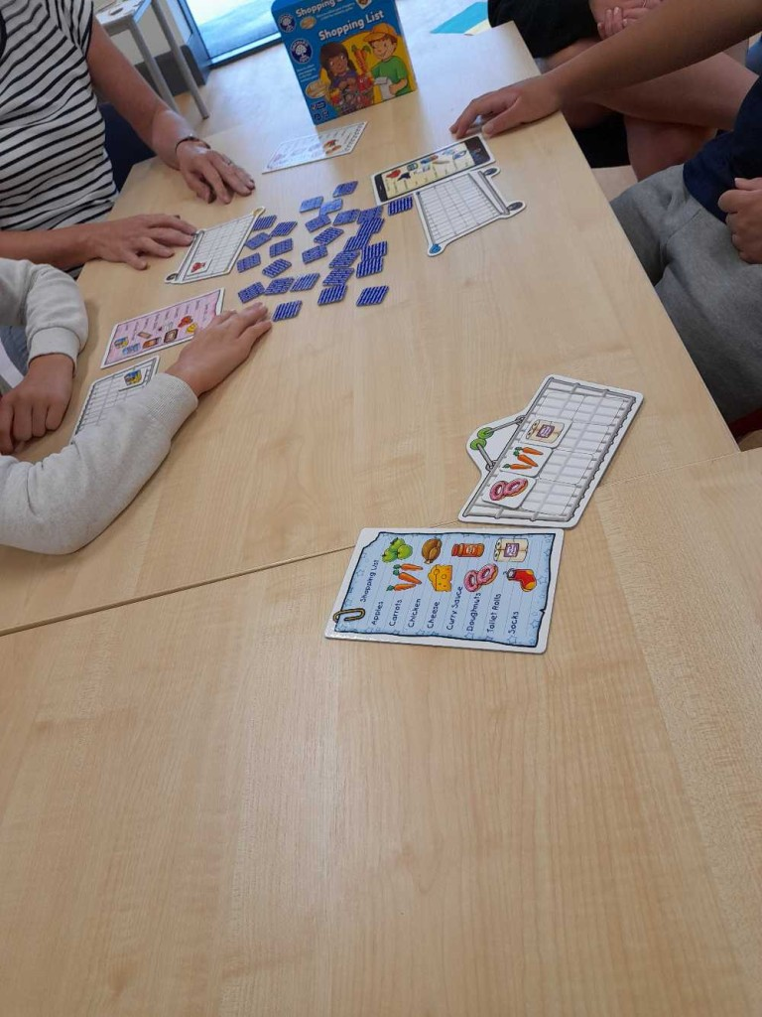
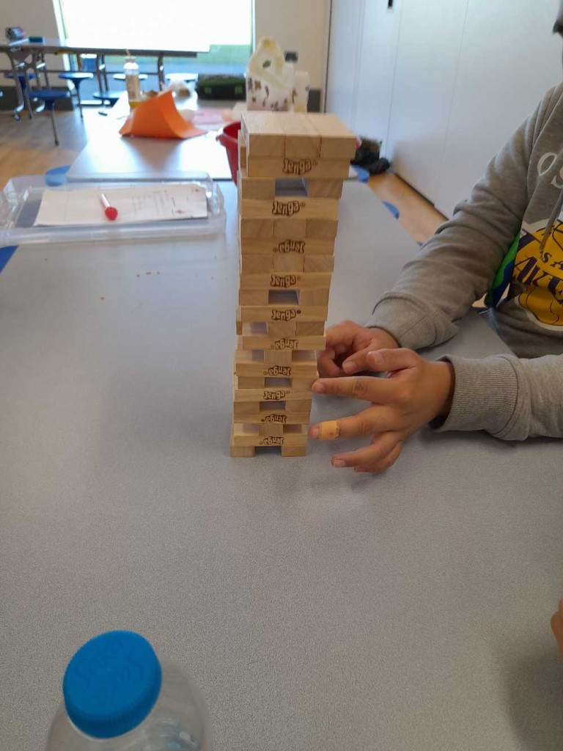
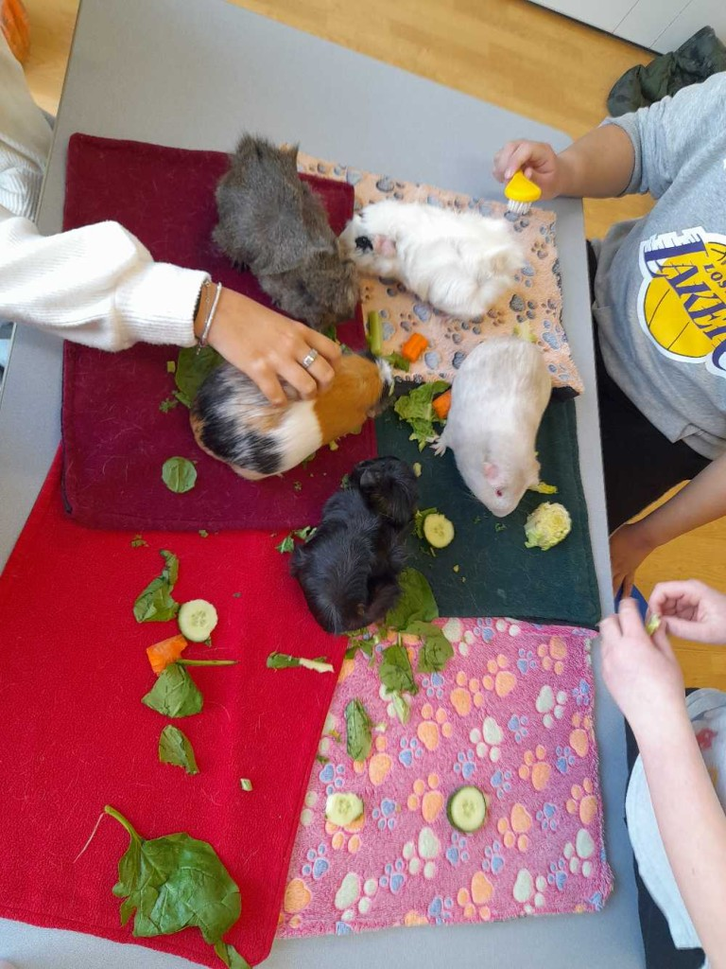
A friend is
A friend is …..
Kind and caring
Supportive
Someone you can laugh or cry with
Someone who helps you out
Who is there no matter what
Encouraging
To share life’s adventures with
Like-minded
Someone who we can have a strong bond with
Someone who can challenge us in a positive way
Respectful

Slide 5
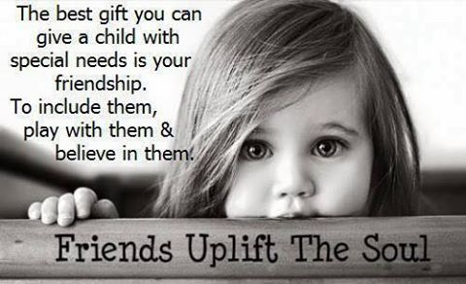
Friends

Slide 6
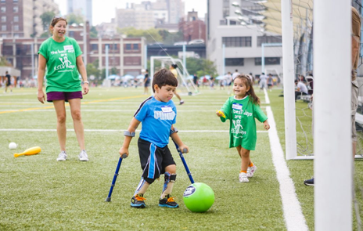
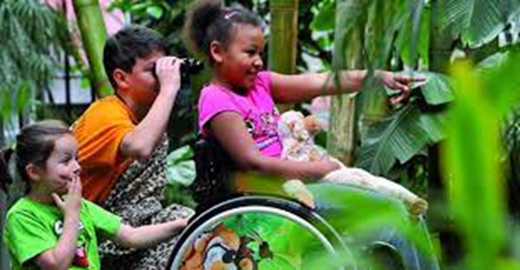
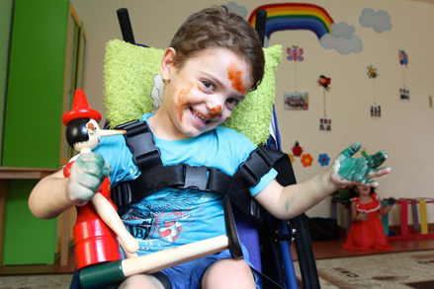
How do children benefit from friendships?
Develop
social skills
language and communication skills
emotional regulation
empathy
problem solving skills
a sense of belonging and a sense of self
curiosity
Learn to
trust and share
respect
They open their minds to new opportunities in life

Slide 7
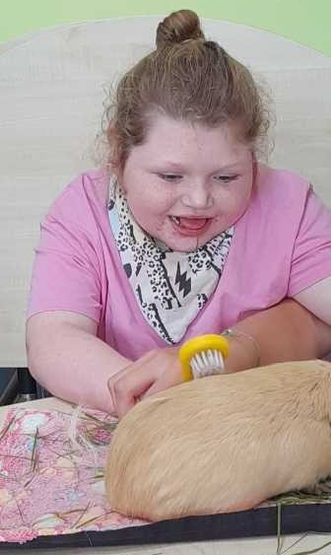
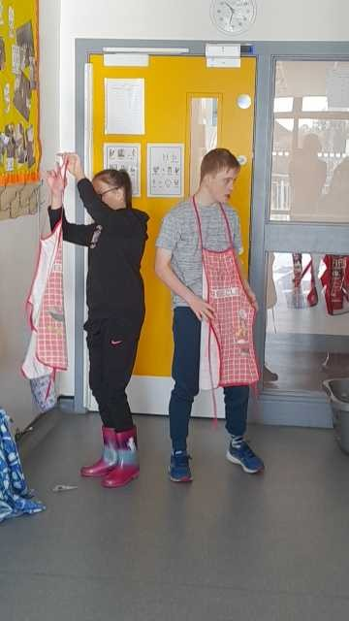
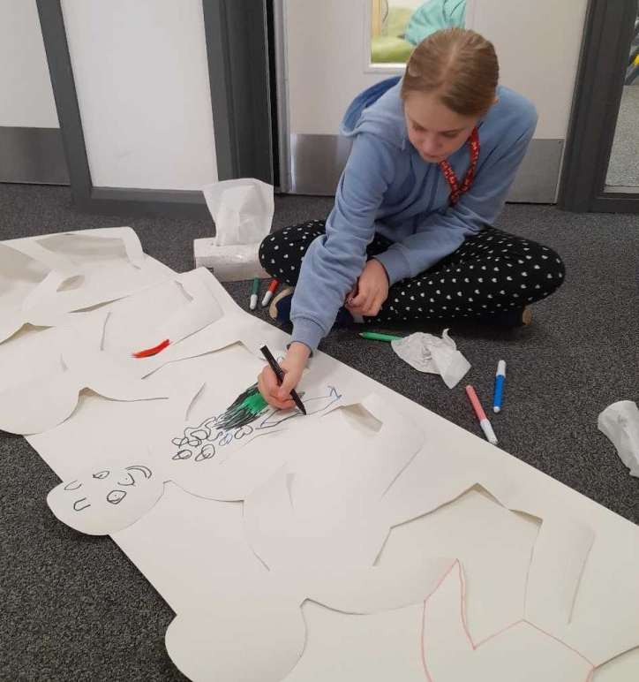
To develop friendships we need opportunity to....
play together or alongside others
share interests and ideas
experience emotions
chat
have fun together
be together

Slide 8
Opportunities
Opportunities to develop friendship among children with SEND are not the same as typically developing children. Why is that?
Slower processing - children with SEND tend to have delayed response to social situations and then the moment is gone.
Difficulties with communication, listening and comprehension which affect the give & take of natural conversations.
Challenging behaviours such as impulsivity or intense emotions.
The presence of a hovering adult (TA/LSA) in class or in the playground can influence the perspective of other children to view the SEND child as different.
They don't have the same level of independence and control over their own choices.
Adverse Childhood Experiences and attachment issues due to trauma (long periods in hospital, for instance)
(Zoe Ganim and Murray Evely, https://www.psych4schools.com.au/free-resources/friendships-difficulties)

Slide 9
Neurodivergent and neurodiversity
Neurodivergent is a term used for people whose brains function differently in one or more ways than is considered standard or typical.
There are many different ways that neurodivergence presents, ranging from very mild which can be hard to notice to more obvious ways that lead to a person behaving differently than is standard in our society. Autism, ADHD and Tourettes are all under the neurodivergent umbrella as are others.
Each person has a brain that is unique to them; no two brains are quite alike. For over a million people in the UK, these differences mean they are diagnosed with autism, ADHD, dyslexia, dyspraxia or other neurological condition. (https://www.thebraincharity.org.uk/what-is-neurodiversity/)​
​
Making friendships can be difficult for many people however when you are neurodiverse this brings some unique challenges these may present as social anxiety, fear of being vulnerable or struggling to manage the skills needed to make friends which includes communication and how to interact with others.​​
​​
Neurodiversity is described by Harvard as the idea that people experience and interact with the world around them in many different ways; there is no one "right" way of thinking, learning, and behaving, and differences are not viewed as deficits.

Slide 10
Animation

Slide 11
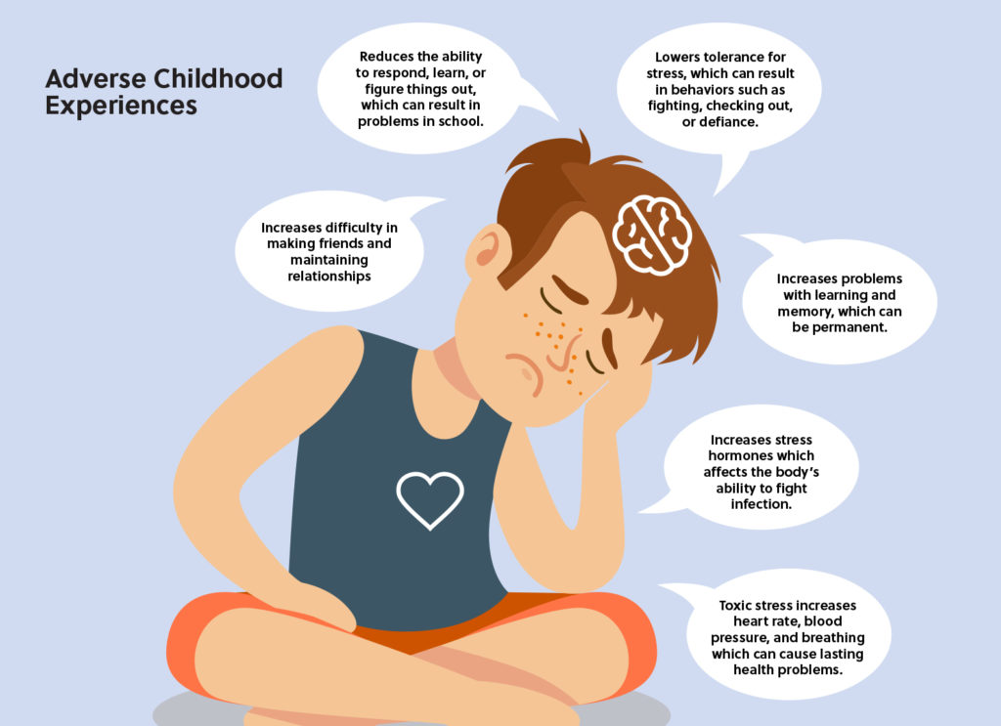
ACEs
Trauma in childhood / ACES might include , being involved in an accident or natural disaster. Or they could include experiences of abuse and neglect or witnessing violence.
Things that are frightening or traumatising for an adult are likely to be even more traumatising for a child. This is because the young child’s limited experience of the world and their developmental stage means they are not yet fully able to understand what’s happening to them or why.​
​
Having a trusted adult around (ideally an attachment figure) can really help a child cope with frightening events. This is why the experience of abuse or neglect by a caregiver is always traumatising – the child is both traumatised by the abuse, and then again by that trauma being caused by someone they should be able to trust.​​
​​
The experience of chronic and complex trauma in early life can have a lasting impact on an individual’s development and personality. However, with the right help, young children can be supported to make sense of distressing experiences, and any negative impact of these experiences on their life chances can be reduced.​​​
​​​
https://www.raleighrescue.org/the-problem/adverse-childhood-experiences/
https://www.annafreud.org/resources/under-fives-wellbeing/common-difficulties/trauma/​

Slide 12
Video

Slide 13
How do we support children
How do we, at our Short Breaks sessions at The Benjamin Foundation, support and create opportunities for our children and young people to find, develop and maintain friendships?
We have a child-led approach to encourage them to find common ground, to flourish and bond.
We go at their pace.
We offer opportunities for them to develop communication and language, play skills, social skills and emotional regulation.
We are also examples of respect and caring attitudes for them to mirror and replicate with the other children.

Slide 14
Case studies
Case studies:
Case study 1: 12 year-old boy
When he started with us, we thought he was non-verbal. He has been coming to our services for 2 years. He now expresses his wishes verbally, in short phrases, and has been showing his fun-loving self, initiating games with adults, giggling, showing affection. He is yet to make some friendship with other children but he has most certainly been testing his skills with us, the adults.
We have offered him a space where he feels secure and safe, we have followed his lead, offered him activities that he likes and slowly introduced new ones. We offer him a total communication approach and opportunities to practise and develop social skills, communication skills and attempt new challenges.

Slide 15
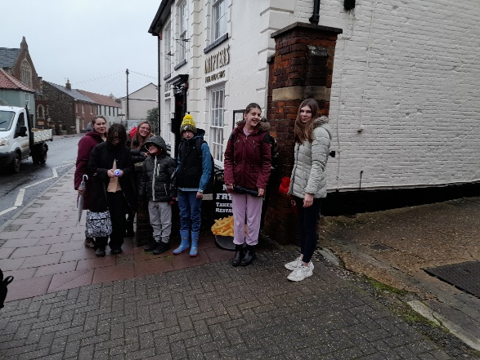
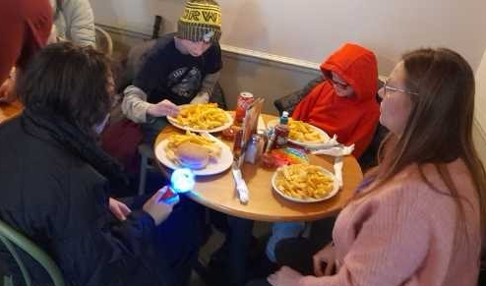
Case study contd
Case studies:
Case study 2: 13 year-old girl
She has been out of school and has suffered trauma; she was struggling with simply leaving her house and had stopped all her activities – horse riding, sports etc. She came to us not sure what she would find but actually found a like-minded boy and they hit it off straight away. At the end of her taster session I asked her if she would like to come again. Her response blew us away: “I didn’t think I’d find anybody to be friends with but I did here. Yes, I’d like to come back. Definitely.”

Slide 16
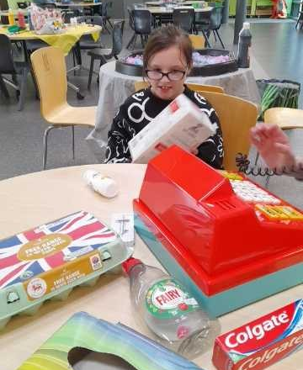
Case studies contd..
Case studies:
Case Study 3: 12 year-old girl
She has difficulty with language and communication but whenever it’s a session day her mum tells us she is up very early, around 4/5am saying she can’t wait to see her friends. She has been building more connections with the other youngsters in the group in every session. She likes to help them and joins in with games and activities. Her confidence is growing all the time.

Slide 17
Case studies…
Case studies:
Case study 4: 10 year-old boy
He uses signing and a communication iPad and is very anxious but he is starting to connect with others through the opportunities we offer. When asked if he wanted to play a ball game with 2 adults or an adult and another child, he chose the latter. His mum has recently asked for more sessions since she can see him making progress.

Slide 18
What families have said about our group
I wanted X to go to a group where she could socialise, feel like a child of the same age, have independence away from me and something she did on her own. As she’s got older and demands have got higher to do stuff it’s difficult to give her the opportunity for independence, the same as other children her age, but having a group like this is a massive thing for X’s development and becoming a young adult.
Our well-being has greatly improved. It’s lovely for her to connect with people outside of school. She is so excited prior to going and then can’t stop talking about what she did and what she made etc etc to anyone and everyone. It reassures me that whilst she is having fun I can knuckle down with the housework, work and connecting with her brother allowing some quality one to one time (I suck at bottle flip lol)
X gets to have more independence and is able to develop his social skills with children from the same area that he lives in. This is sometimes difficult to achieve when attending special school as children come from all over. It also means that his younger sibling and I/daddy get to spend some quality time together. It enables us to have a break.
The hours that my children spend when they are in Benjamin helps them to develop independence and interaction with other people. It has also given us, their parents time to have a break and be able to reboot as their carers and parents.

Slide 19
Feedback
Any questions?
Thank you for attending today ☺
If you would like to join our Specialist Short Breaks teams please follow the link below – the link will appear in the chat. https://benjaminfoundation.co.uk/vacancies/
If you would like a chat to know more about what we do or have any information about vacancies, get in touch with Marcia - marcia.fronyoshea@benjaminfoundation.co.uk

